Slide 1
Rajendra Thapa

Slide 2
Learning Outcome
Describe the epidemiology, impact, and key anatomical structure of spinal pain.
Differentiate between nociceptive, neuropathic, and nociplastic pain and its mechanisms.
Outline the neurophysiological pain pathways, Biopsychosocial model, chronic pain and common spinal pathologies.
Recognize red flags indicating serious or urgent spinal conditions.
Apply clinical reasoning in assessment and diagnosis.
Discuss evidence-based management using exercise, manual therapy, adjunctive approaches, pharmacological and surgical management.
Integrate exercise, education, and self-management into personalized care plans
Understand various outcome measures of spinal pain

Slide 3
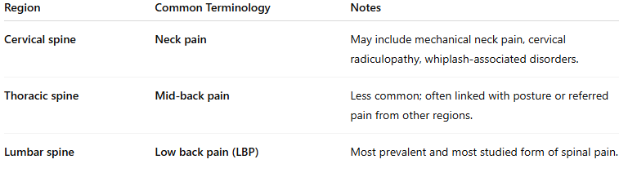
Introduction to Spinal pain

Slide 4
Epidemiology of spinal pain in the globally
Neck pain globally
Highly widespread condition, with an age-standardized incidence of 807 per 100,000 globally in 2017
Neck pain in the UK:
Common — up to 70% of the population, will suffer at some point in their lives.
Prevalence peaks between the ages of 45 and 54.
Global: Thoracic pain
Estimated the prevalence of in 13% of the general population
Less documented
MSK Global:
One of the top reasons why patients seek medical care
LBP is Responsible for more disability than any other Musculoskeletal (MSK) condition
Low back pain globally:
In 2020, affected 619 million people (1 in 13), with cases expected to rise to 843 million by 2050 due to population growth and ageing
Highly prevalent worldwide, affecting up to 60% of adults at some point in their lives, with 3–4% of adults under 45 and 5–7% of those over 45 years experiencing chronic symptoms
Low back pain the UK
Most cases are non-specific, accounting for 90–95% of presentations to primary care
1% case are specific cause such as fracture, infection, tumour, AS and 8-10% radicular pain
Prevalence has increased over time, with one-year rates rising from 36.4% to 49.1% and one-month prevalence around 28.5%, peaking in adults aged 41–50 years and remaining common in older adults
Reported by one in four people aged over 80 years, Most common in women and people aged 40–80 years.
Notes:
Bateman, E.A., Fortin, C.D. and Guo, M. (2024). Musculoskeletal mimics of lumbosacral radiculopathy. Muscle & nerve. doi:https://doi.org/10.1002/mus.28106.
Manchikanti, L., Singh, V., Datta, S., Cohen, S.P. and Hirsch, J.A. (2009). Comprehensive Review of Epidemiology, Scope, and Impact of Spinal Pain - ProQuest. [online] www.proquest.com. Available at: https://www.proquest.com/openview/151b4bb51a4c7f8660c7f09b620abe1e/1?pq-origsite=gscholar&cbl=5453642 [Accessed 19 Apr. 2024].
Wu, H., Li, Y., Zou, C., Guo, W., Han, F., Huang, G. and Sun, L. (2025). Global burden of neck pain and its gender and regional inequalities from 1990 - 2021: a comprehensive analysis from the Global Burden of Disease Study 2021. BMC Musculoskeletal Disorders, 26(1). doi:https://doi.org/10.1186/s12891-025-08331-6.
https://www.who.int/news-room/fact-sheets/detail/low-back-pain
https://cks.nice.org.uk/topics/back-pain-low-without-radiculopathy/background-information/prevalence/

Slide 5
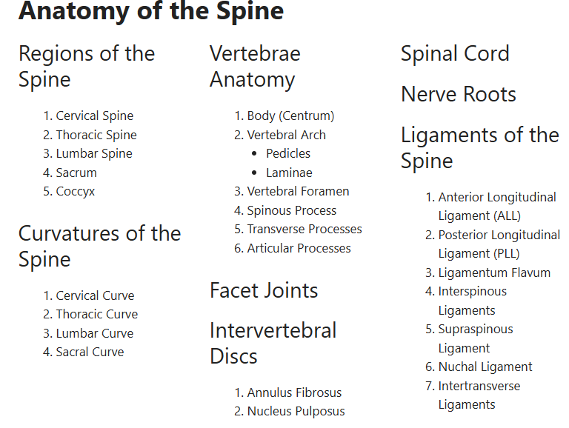

Slide 6
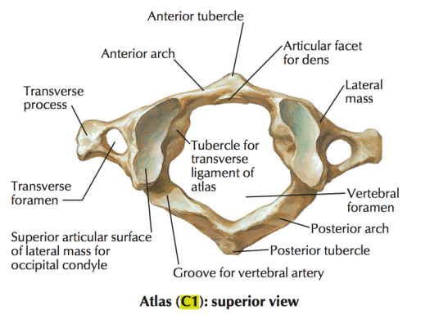
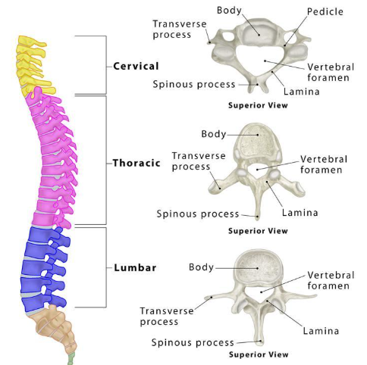
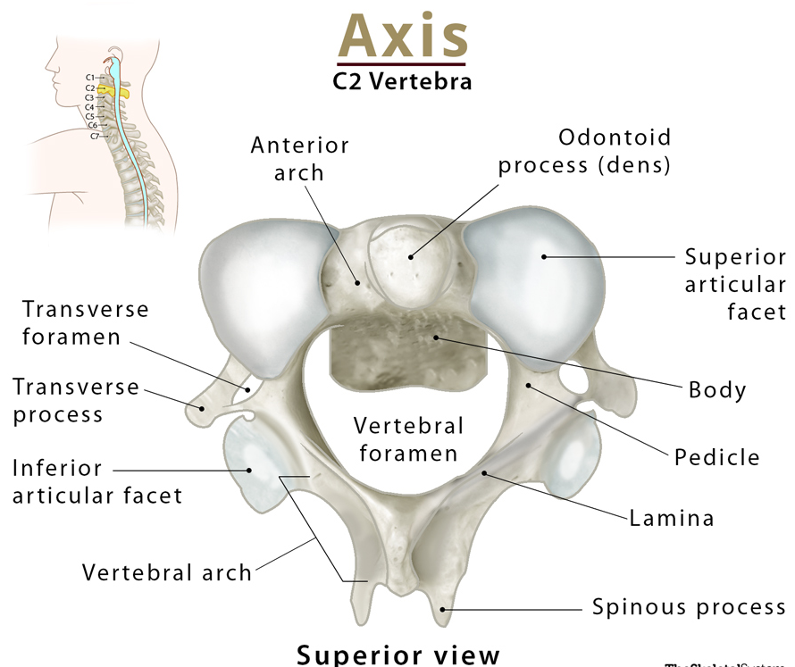
Anatomy Contd…..

Slide 7
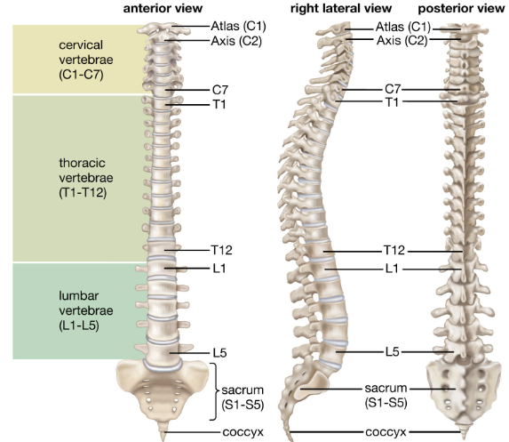
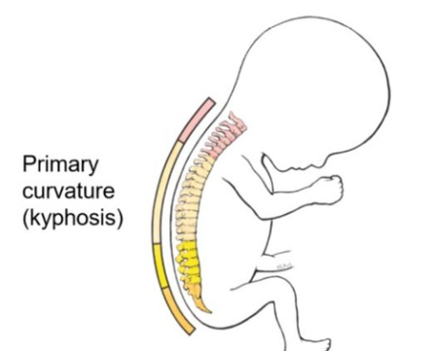
Anatomy Contd…
At birth, the spine has primary kyphotic curves. As a child develops an upright posture, secondary cervical and lumbar curves form, creating lordosis in these regions..
Atlas (C1): Supports the skull, allows head nodding
Axis (C2): Enables rotation (side to side motion ‘no’)
Posterior column consists of articular process and facet joint which provides gliding mechanism
Functions: supports body, enables movement, protects spinal cord and blood vessels
Notes:
Protecting Blood Vessels: Vertebrae C1–C6 contain openings called transverse foramina, which serve as protective pathways for arteries carrying oxygen-rich blood to the brain.

Slide 8
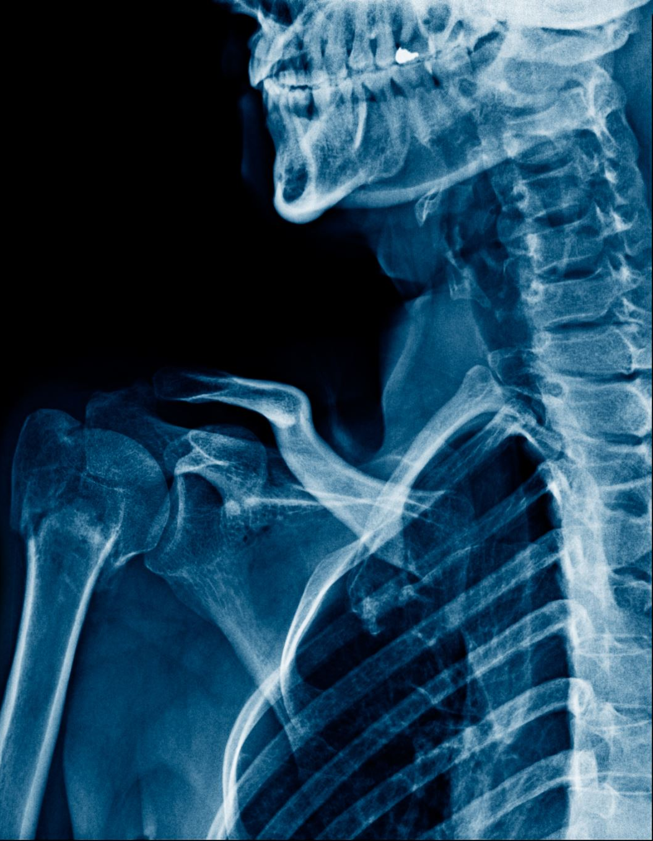
Anatomy contd..
Functionally, vertebral column consists of anterior and posterior column
Anterior column is weight bearing and hydraulic with shock absorbing capability which consists of vertebral bodies intervertebral disks (IVDs)
Human vertebral column (spine) is designed for the structural stability for full mobility and protection of the spinal cord and axial neural tissues
Spine also contribute to functional requirement of gait and maintenance of static weight bearing posture
Basic building block of the spine is the vertebrae
Although sufficient for static load, not have necessary flexibility for dynamic load bearing

Slide 9
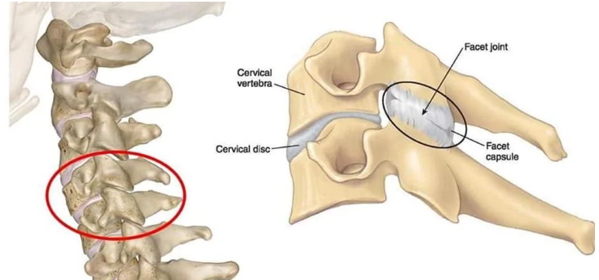
Facet Joints
A motion segment in the vertebral column is defined as two adjacent vertebrae and three joints (one joint is formed between two vertebral bodies and IVDs, and other two joints between facet joints)
Vertebral column consists of 24 pairs of facet joints
The facet joints are plane joints as articular surfaces are flat, covered with hyaline cartilage and synovial in nature
The articular process of facet joints allow certain movement and resists excessive torsions and shear
Horizontal articular surface favours axial rotation like in cervical region (progress horizontal to 45 degree vertical in lower cervical segments)
In thoracic spine almost vertical direction with coronal orientation which facilitate axial rotation and resists anterior displacement
In lumbar spine vertical in with a curved, J shaped surface essentially in sagittal plane which restricts rotation and resists anterior shear
Facet joint play important role in examination and intervention of mechanical spinal disorders

Slide 10
Intervertebral discs
Lies between adjacent superior and inferior vertebral bodies from C2 to S1 and similar in shape to the respective vertebral bodies
Largest avascular structure in the bodies
Each disk composed of inner nucleus pulposus and outer annulus fibrosus and limiting cartilage end plates
The annulus and end plates anchor the IVD to the vertebral bodies
IVD contribute to 20-25% of the length of vertebral column
In the cervical and lumbar region, IVDs are thicker anteriorly and this contribute to the normal lordosis
In the thoracic spine, IVDs is of uniform thickness
Although incapable of independent motion, it moves during flexion, extension, side flexion and rotation.
The intervertebral discs (IVDs) have to handle several types of forces — pressure from above (axial compression), sliding forces (shear), and movements such as bending and twisting, either on their own or happening together

Slide 11
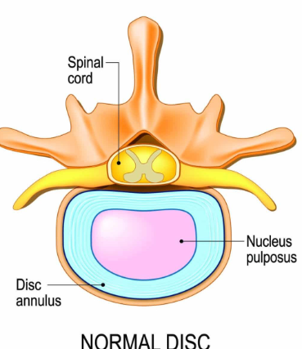
Disc contd..
Structure: locate between C2 to S1 vertebral bodies
  Nucleus Pulposus
    Gel-like inner core
    Rich in water and proteoglycans
    Resists compressive forces
  Annulus Fibrosus
    Outer fibrous rings of collagen
    Provides tensile strength and limits excessive movement
  Cartilaginous Endplates
    Thin layers of hyaline cartilage
    Connect disc to adjacent vertebral bodies
    Allow nutrient diffusion into the disc
    Function:
  Acts as a shock absorber
  Provides flexibility and mobility to the spine
  Transmits and distributes loads between vertebrae

Slide 12
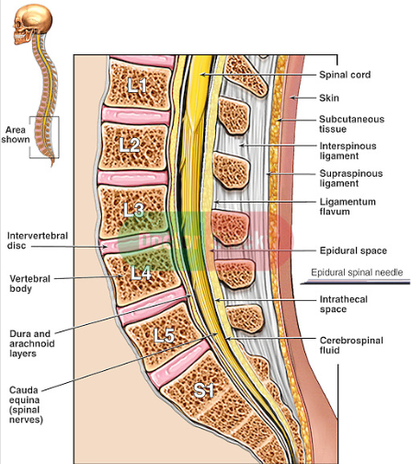
Major and Accessory Spinal Ligaments
Major Ligaments
1. Anterior Longitudinal Ligament (ALL)
Origin: Anterior tubercle of atlas (C1) and anterior surface of occipital bone
Insertion: Anterior surface of sacrum
Function: Prevents hyperextension of the vertebral column
2. Posterior Longitudinal Ligament (PLL)
Origin: Posterior aspect of vertebral bodies from C2
Insertion: Posterior surface of sacrum
Function: Limits hyperflexion; supports intervertebral discs
3. Ligamentum Flavum
Origin: Anterior surface of lamina above
Insertion: Posterior surface of lamina below
Function: Maintains upright posture, assists in extension after flexion

Slide 13
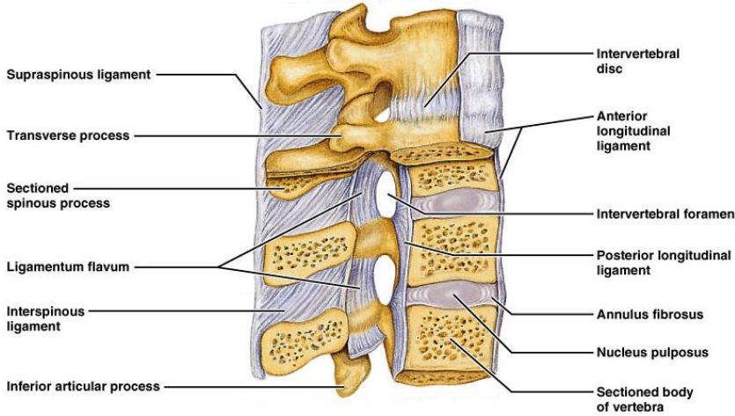
Spinal ligament contd..
Accessory ligaments
1.Interspinous Ligament
Origin: Inferior edge of spinous process above
Insertion: Superior edge of spinous process below
Function: Limits spinal flexion
2. Supraspinous Ligament
Origin: Spinous process of C7 (continuation of nuchal ligament)
Insertion: Sacral spinous processes
Function: Limits flexion; connects tips of spinous processes
3. Ligamentum Nuchae
Origin: External occipital protuberance & posterior border of foramen magnum
Insertion: Spinous processes of cervical vertebrae (C1–C7)
Function: Limits cervical flexion; provides muscle attachment
4. Intertransverse Ligament
Origin: Inferior border of transverse process above Insertion: Superior border of transverse process below
Function: Limits lateral flexion of the spine

Slide 14
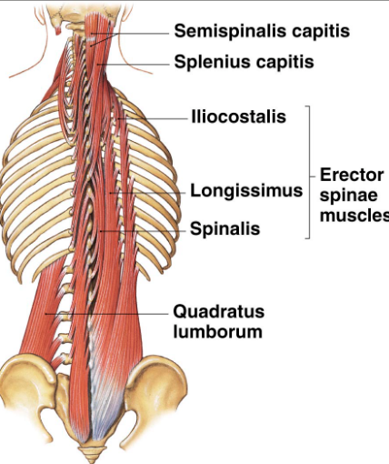
Superficial and Intermediate Muscles of the Back
1.Trapezius
Origin: External occipital protuberance, ligamentum nuchae, spinous processes of C7–T12
Insertion: Lateral 1/3 of clavicle, acromion, spine of scapula
Action: Elevates, retracts, and rotates scapula
2. Latissimus Dorsi
Origin: Spinous processes of T7–L5, thoracolumbar fascia, iliac crest
Insertion: Intertubercular sulcus of humerus
Action: Extends, adducts, and medially rotates arm
3. Levator Scapulae
Origin: Transverse processes of C1–C4
Insertion: Medial border of scapula above spine
Action: Elevates scapula
4. Rhomboid Major & Minor
Origin: Spinous processes of C7–T5
Insertion: Medial border of scapula
Action: Retracts and rotates scapula
5. Serratus Posterior (Superior & Inferior)
Function: Assist in respiration (proprioceptive role)
1. Splenius (Capitis & Cervicis)
Origin: Nuchal ligament, spinous processes of C7–T6
Insertion: Mastoid process, transverse processes of C1–C3
Action: Extend and rotate head
2. Erector Spinae Group (Iliocostalis, Longissimus, Spinalis)
Origin: Sacrum, iliac crest, spinous processes of lumbar vertebrae
Insertion: Ribs and transverse processes up to skull
Action: Extend and laterally flex vertebral column
3. Transversespinalis Group (Semispinalis, Multifidus, Rotatores)
Origin: Transverse processes of vertebrae
Insertion: Spinous processes above
Action: Stabilize and rotate vertebral column
4. Interspinales & Intertransversarii
Function: Assist in small movements and stabilization of vertebrae

Slide 15
Biomechanics
The principal movements are flexion, extension, side flexion and rotation
Other movement are compression/distraction, and Anterior/posterior/lateral shear
ALL restrict hyperextension, PLL restrict flexion, SF and rotation are limited by facet joints, capsule and facet joint ligaments
Facet joints are not normally weight bearing joints, vertebrae and intervertebral discs are weight bearing joints
Most compressive force are absorbed by the discs , the facet joint bear weight only in extension
The discs of the lumbar spine account for 25% of the total height of the lumbar spine
Lumbar discs are most common disc to prolapse
Disc contain 95% water in 20-year-old and 60% in 80-year-old

Slide 16
2. Pain mechanism

Slide 17
Pain Mechanism
Pain is defined by the International Association for the Study of Pain as “an unpleasant sensory and emotional experience associated with a real or potential tissue injury or described regarding damage
Pain pathways are complex, dynamic, sensory, cognitive, and behavioural systems that evolved to recognise, integrate, and coordinate a protective reaction to noxious stimuli, involving primitive spinal responses and the complex emotional responses humans consciously experience as pain
Several structures of the Central Nervous System (CNS) compose pain pathways: the spinal cord, thalamus, amygdala, hypothalamus, periaqueductal grey (PAG) matter, basal ganglia, the insular, cingulate cortex, sensory and motor cortices

Slide 18
Pain mechanism
Pain pathways are significant in clinical applications as they underlie pain perception and provide pain management targets
Pain Mechanism
1. Transduction:
Tissue injury releases chemicals (e.g., bradykinin, prostaglandins, histamine, ATP).
These activate nociceptors (pain receptors) in the skin, muscles, or organs (silent nociceptors).
2. Transmission:
Pain signals travel via Aδ (fast) and C (slow) fibers → spinal cord (dorsal horn) → brain (thalamus & cortex via spinothalamic tract).
3. Modulation:
Descending pathways from brainstem (e.g., serotonin, norepinephrine, endorphins) inhibit or amplify pain signals in the spinal cord.
4. Perception:
Brain interprets signals as pain, influenced by emotion, memory, and context.
Notes:
Pain Pathways - TeachMePhysiology

Slide 19
Neuroplasticity
Peripheral Sensitization or hyperexcitability
Happens at the site of injury.
When tissues are damaged, they release chemicals (like prostaglandins, bradykinin, histamine).
These make the pain receptors (nociceptors) more sensitive.
Result → even light touch or mild stimuli can feel painful.
(Example: Sunburned skin feels sore even with a gentle touch.)
Adaptive and self limiting
Central Sensitization
Occurs in the spinal cord and brain.
Continuous pain signals from the periphery make the spinal neurons overactive.
This causes increased pain sensitivity and pain spreading beyond the original injury area.
(Example: Chronic back pain that becomes widespread.)
Can be maladaptive and create pain in the absence of any noxious stimulus
Key mechanism of chronic pain
Hyperalgesia: Increased pain from stimulus that normally provokes pain: Primary and secondary
Allodynia: Pain due to a stimulus that does not normally provoke pain
Notes:
Pain Pathways - TeachMePhysiology

Slide 20
Who gets Central sensitization
Occasionally present
Low back pain
Shoulder pain
Rheumatoid arthritis
Non traumatic neck pain
Tendinopathy
Post cancer pain
Tennis elbow
Patello femoral pain
Often present
Fibromyalgia
Chronic fatigue syndrome
Osteoarthritis
Whiplash
IBS
Migraine
Tension type headache
Complex regional pain syndrome
Neuropathic pain
Chronic pelvic pain
TMJ disorder
Carpal tunnel syndrome

Slide 21
Chronic (persistent pain)
Non modifiable risk factors:
Increasing age
Female gender
Ethnic and cultural background
History of trauma, abuse and violence
Genetic predisposition
Pain which has persisted beyond normal tissue healing time, which is assumed to be 3 months
Chronic pain is maladaptive
One of the leading cause of global disease burden
Has modifiable and non modifiable risk factors
Should be considered a diseases in its own right
Modifiable Factors
Severe pain, increasing number of pain sites
MSK cause
Anxiety, depression, catastrophising
Presence of other chronic disease
Obesity
Exercise Sleeping difficulties, unemployed, Poor job control
Low level of sunshine, temperature
Low socioeconomic class, income and education

Slide 22
Descending modulation
The brain can control how much pain you feel by sending signals down to the spinal cord.
Descending Inhibition (reduces pain):
Brain areas like the periaqueductal gray (PAG) and rostral ventromedial medulla (RVM) release chemicals such as
  Serotonin (5-HT)
  Norepinephrine (NE)
  Endorphins (natural painkillers)
These block or reduce pain signals before they reach the brain.
Descending Facilitation (increases pain):
In some chronic pain states, the brain amplifies pain instead of reducing it.

Slide 23
Factors influence the pain
Strength of the stimulus
Position of the structure in the dermatome
Depth of the structure
Type or nature of the structure

Slide 24
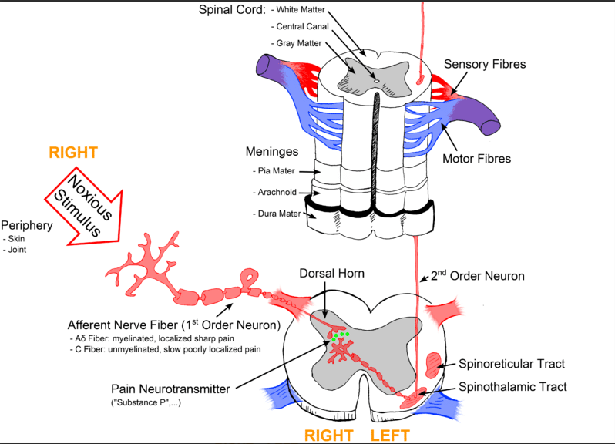
Notes:
https://teachmephysiology.com/nervous-system/sensory-system/pain-pathway/

Slide 25
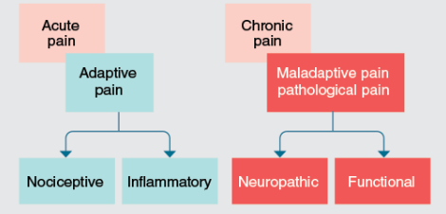
Classification of pain
Acute :
Acute: less than 6 weeks
Subacute: 6 weeks to 3 months
Chronic pain:
Over 3 months

Slide 26
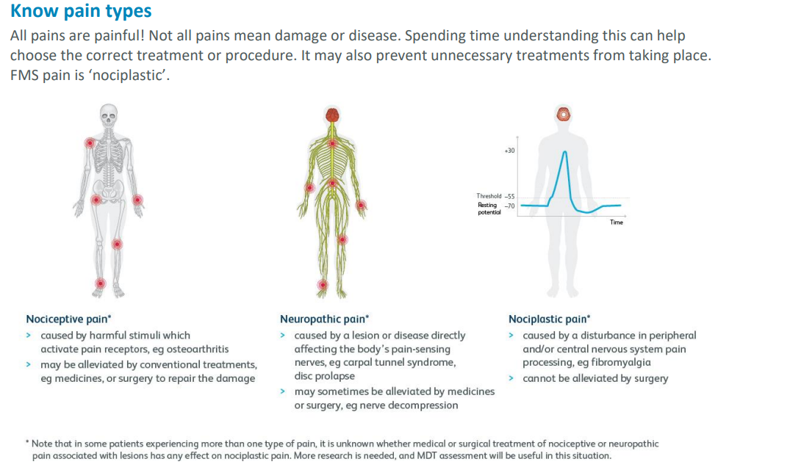

Slide 27
Differentiate between nociceptive, radicular, neuropathic and nociplastic pain mechanisms.
Pain terminology | Source | Description
Nociceptive | Activation of peripheral nociceptors in tendon, ligaments muscle, fascia, viscera, skin via thermal, mechanical or chemical stimuli Can be divided in to visceral and somatic (deep and superficial) | Unpleasant sensation. Not perceived as pain until higher centre reached
 | Visceral: Visceral nociceptors in internal organs; highly sensitive to stretch , ischaemia and inflammation | Diffuse, dull or heavy vague sensation not well localiased
 | Somatic: activation of peripheral nociceptors in tendon, ligaments, muscle, fascia, and skin. Can be deep or superficial structure dependant Inflammatory Pain: Due to activation of inflammatory mediators | Dull aching. If a deep structure, poorly localised. If a superficial structure, sharp, well defined and clearly located
Radicular | Pressure or damage to nerve root: Inflammation or other irritation of the nerve root | Sharp, shooting pain or stabbing pain in distinct lines within the relevant dermatomal pattern for the level affected. Can be associated with weakness and paraesthesia
Neuropathic | Caused by nerve damage or disease (pathology of nervous system) that affect the somatosensory nervous system. Burning, shooting or electric pain, numbness, tingling or allodynia | Peripheral: Diabetic neuropathy, post herpetic neuralgia, CRPS Central: MS, Stroke, SCI
Nociplastic | Nociplastic (algopathic or nocipathic) pain is defined as pain that arises from altered nociception without clear evidence of nociceptive or neuropathic pain. Altered CNS pain processing, no lesion or nerve or structural pathology | No neurological deficits, Diffused, aching, and pressure like pain. Fibromyalgia, chronic tension headache
Notes:
https://www.painphysicianjournal.com/current/pdf?article=MjMyNQ%3D%3D&journal=88
Atkins, E., Kerr, J. and Goodlad, E. (2016). A Practical Approach to Musculoskeletal Medicine : Assessment, Diagnosis, Treatment. Edinburgh: Elsevier.

Slide 28
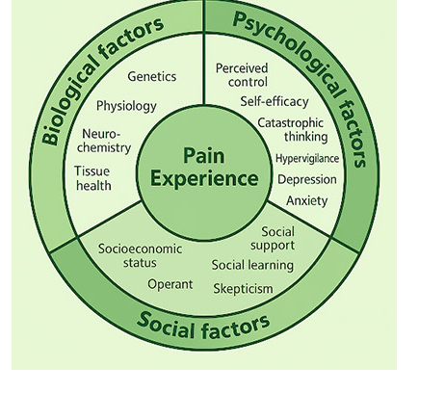
Biopsychosocial model of pain
Pain is a personal, multidimensional experience, not merely a symptom of tissue damage.
Arises from a dynamic interaction of biological, psychological and social factors
These factors are interdependent, not separate — they shape the individual’s lived pain experience.
A biopsychosocial approach can be applied by a single clinician using multiple strategies that address biological, psychological, and social factors.
In complex or chronic cases, a multidisciplinary or interdisciplinary team may be required to deliver comprehensive assessment and care.
Notes:
https://europeanpainfederation.eu/what-is-the-bio-psycho-social-model-of-pain/

Slide 29
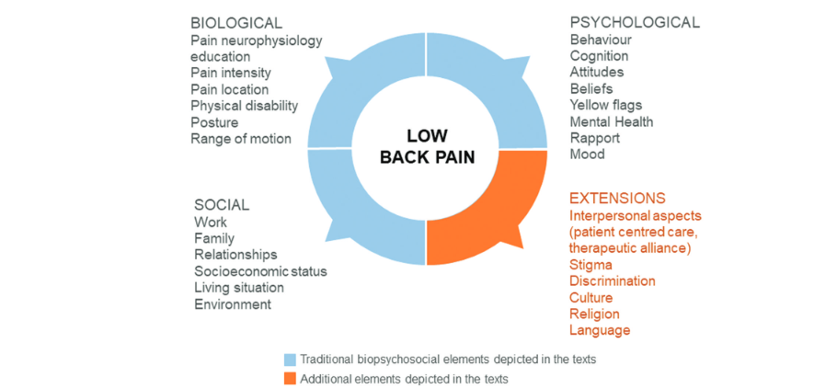
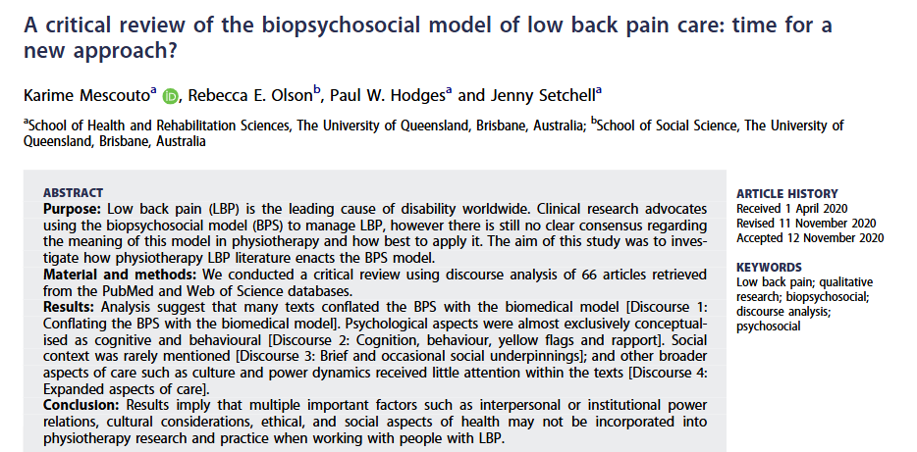
Extension of BPS
Notes:
https://pubmed.ncbi.nlm.nih.gov/33284644/

Slide 30
Features of inorganic Pain
Non recognizable pattern of symptoms or sign in the history and examination
Poor cooperation throughout the assessment
Overly eager or exaggerated responses, often showing satisfaction if diagnosis is unclear
Patient may seek the answer expected of them
Contradictory signs due to limited understanding of the condition
Notes:
A practical approach to musculoskeletal medicine: Assessment, diagnosis and treatment

Slide 31
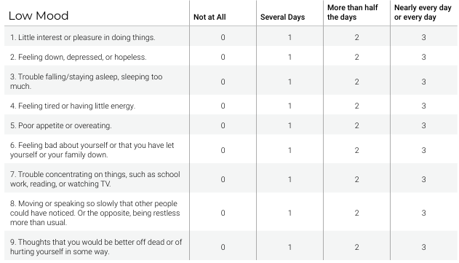
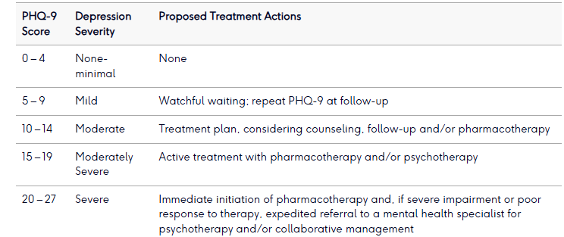
Patient health Questionnaire (PHQ-9)
Help in screening, diagnosing, monitoring severity of anxiety
Question asked based on last 2 weeks
Used in 15 years or older
Questions: https://patient.info/doctor/mental-health/phq-9
Notes:
https://www.physio-pedia.com/Generalised_Anxiety_Disorder
https://patient.info/doctor/mental-health/phq-9
https://pmc.ncbi.nlm.nih.gov/articles/PMC7549295/

Slide 32
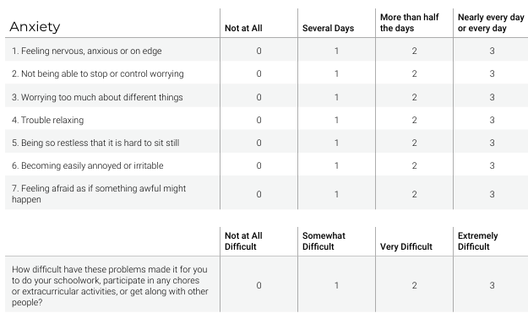
Generalised anxiety disorder (GAD 7)
It is one of the common mental health disorder
Generalized anxiety disorder produces fear, worry, and a constant feeling of being overwhelmed
Worry could be multifactorial
Questionnaire: https://patient.info/doctor/mental-health/gad-7
Anxiety severity scale
0–4: minimal anxiety
5–9: mild anxiety
10–14: moderate anxiety
15–21: severe anxiety
Notes:
https://patient.info/doctor/mental-health/gad-7
https://pubmed.ncbi.nlm.nih.gov/16717171/

Slide 33
Causes of back pain
Low back pain without serious underlying pathology-85%
Compression fracture-4%
Tumour-1%
Prolapse Intervertebral disc-1-3%
Ankylosing spondylitis, spinal infection, intraabdominal pathology <1%

Slide 34
Risk factors for the development of Non-specific and chronic back pain
Non-Specific low back pain
Obesity
Physical inactivity
Occupational factors (such as heavy lifting, bending, or twisting)
Stressful life events or depression
Chronic pain and disability
Pain lasting longer than 12 weeks
High baseline pain intensity and disability.
Anxiety and/or depression or Stressful life events such as physical or emotional trauma.
Previous or current substance misuse.
Perceived risk of persistent pain.
Maladaptive coping strategies and 'fear avoidance' or negative beliefs about pain and activity.
Pain coping characterized by excessively negative thoughts about pain and the future ('catastrophizing').
Past history of other chronic pain syndrome(s).
Notes:
Nice guidelines

Slide 35
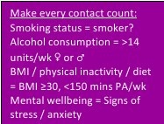
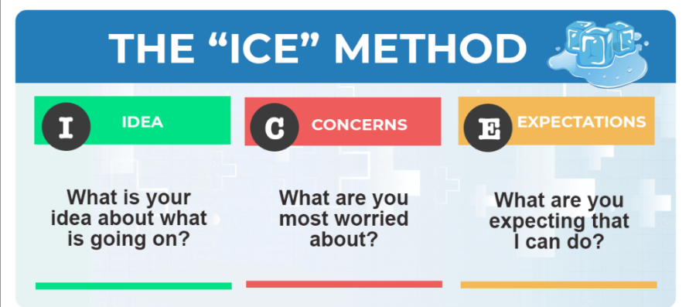
Assessment and examination
Age, occupation, sports, hobbies and lifestyle
Site and spread
Onset and duration
Symptoms and behaviour
Medical history
Other joint involvement
Medications
Constitutional symptoms
Anxiety and Depression
Notes:
A practical approach to musculoskeletal medicine, Dutton Orthopaedic
Textbook of orthopaedic Trauma and Rheumatology
https://stpsupport.nice.org.uk/mecc/index.html#group-section-The-MECC-approach-Sd0eBNaUnA
https://pubmed.ncbi.nlm.nih.gov/36408805/

Slide 36
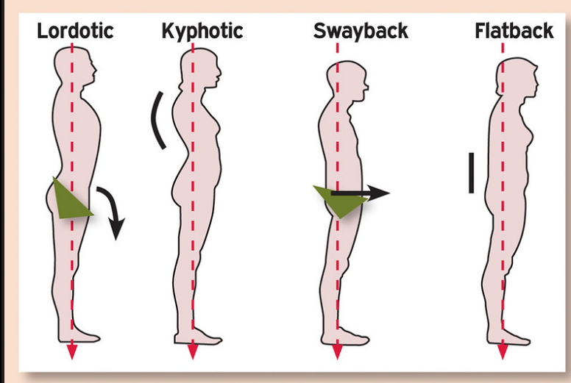
Examination
Posture and gait
Inspection: Bony deformity, scoliosis colour change, muscle wasting, swelling, muscle spasm
Palpation: Heat, swelling, synovial thickening
AROM
PROM
Resisted AROM
Capsular pattern
Neurological testing
Capsular Pattern :
Cervical and Thoracic Spine:
Equal limitation of rotations, SFs
Some limitation of extension
Usually full flexion
Lumbar Spine:
Most limitation of extension
Equal limitation of side flexions
Usually full flexion

Slide 37
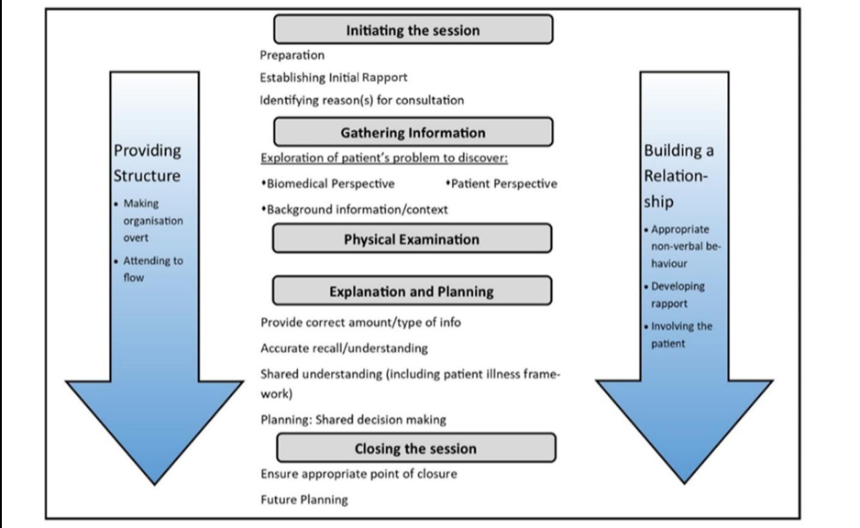
Calgary-Cambridge model of consultation
Effective communication is vital component of patient consultation
It is a structured communication model
This is a patient centred model
It Is a practical and evidence- based approach of data gathering, relationship building and shared decision making
Notes:
https://pmc.ncbi.nlm.nih.gov/articles/PMC11210582/
https://www.physio-pedia.com/Calgary-Cambridge_Guide_to_the_Medical_Interview_-_Initiating_the_Session

Slide 38
Special Tests for Back Pain ± Radiculopathy
Used to support or refine working diagnosis
Lower back
Straight Leg Raise (SLR) Test
  Assesses lumbar nerve root irritation (L4–S1), Pain re produce at 30–70° hip flexion
Crossed Straight Leg Raise Test
  Elevating the unaffected leg reproduces pain in the affected leg, specific for herniated disc with nerve root compression
Femoral Nerve Stretch Test
  Patient lies prone; knee is flexed and hip extended, Pain in anterior thigh suggests L2–L4 radiculopathy
Slump Test:
  Patient slumps forward with neck flexion, knee extended
  Positive if radicular symptoms reproduced, Tests neural tension in the sciatic nerve and spinal cord
Faber test: SI joint pathology, Reproduce pain in Hip or SI joint during test
SI Joint Compression/Distraction test: SI joint pathology, reproduce pain during test
Neck:
Cervical distraction test: Cervical nerve root compression, relieve of symptoms during test
Spurling test:
Used for Cervical nerve root compression, reproduction of symptoms during test
Shoulder abduction test: Cervical radiculopathy at C5-C6, relieves symptoms during test
ULNTTs (Upper limb nerve tension test):
For median, radial and ulnar nerve, reproduce symptoms
Lhermitte's sign: :Flexion of neck causes electric shock like sensation down to spine. Common in MS
Hoffman Test: is indicative of an upper motor neuron lesion
Notes:
Dotton Orthopaedic
https://www.physio-pedia.com/Hoffmann's_Sign

Slide 39
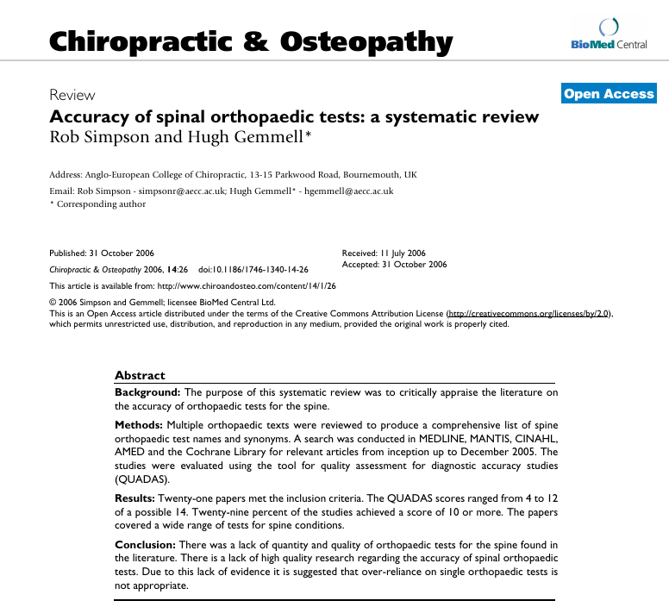
Notes:
https://link.springer.com/article/10.1186/1746-1340-14-26?utm_source=chatgpt.com

Slide 40
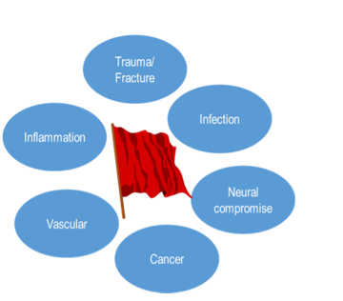
Serious and other risk factors
🚩Red Flag:
Serous medical conditions
Polymyalgia rheumatica and giant cell arteritis
Cervical/Carotid artery dysfunction
Cervical myelopathy
Cauda Equina Syndrome
Spinal malignancy
Vertebral Fracture
Spinal infection eg discitis or TB
Trauma
Inflammatory back pain
Night pain or pain at rest
Progressive neurological disorder
Yellow flags:
Psychological risk factors: About the person
Anxiety, depression, low mood, passive coping strategy, fear avoidance behaviour
Orange flags: Clinical psychiatric disorder
Clinical depression, PTSD, Suicidal ideation, substance abuse, Psychosis, personality disorder
Blue flags: About the work-place and related risk factors
Poor job satisfaction, belief that work is harmful, unsupportive work environment
Black flags: System, policy or contextual factors
Litigation issues, Insurance or legal disputes, inflexible work-place policies and delay in care
Notes:
https://musculoskeletalkey.com/decision-making-and-flag-systems/

Slide 41
Symptoms: Red Flags
Indicate potential serious underlying pathology
– May relate to musculoskeletal or systemic illness.
Not diagnostic
– Signal the need for further investigation, not a definitive diagnosis.
Cumulative effect
– More red flags = higher likelihood of significant pathology.
Management depends on suspected cause
– Suspected cancer → Urgent 2-week wait referral.
– Suspected septic arthritis or cauda equina → Emergency same-day hospital referral.

Slide 42
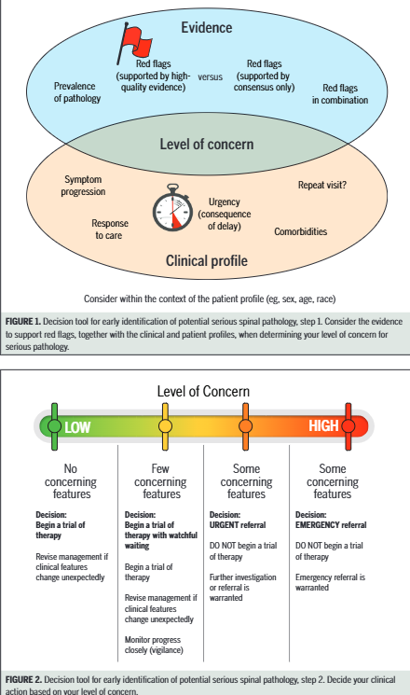
Red Flags
Notes:
https://www.jospt.org/doi/epdf/10.2519/jospt.2020.9971

Slide 43
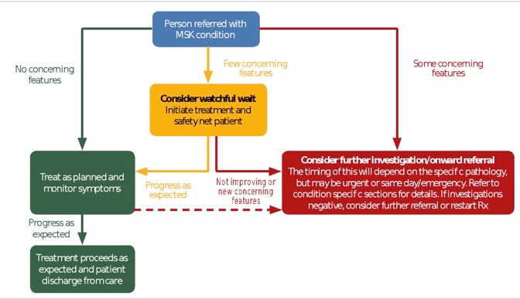

Slide 44
Several ways of classification of low back pain
Low back pain
Mechanical
Non Mechanical
Visceral
Low back pain
Structural pathology
Neurological Etiology
Extraspinal etiology
Notes:
https://pmc.ncbi.nlm.nih.gov/articles/PMC10876847/

Slide 45
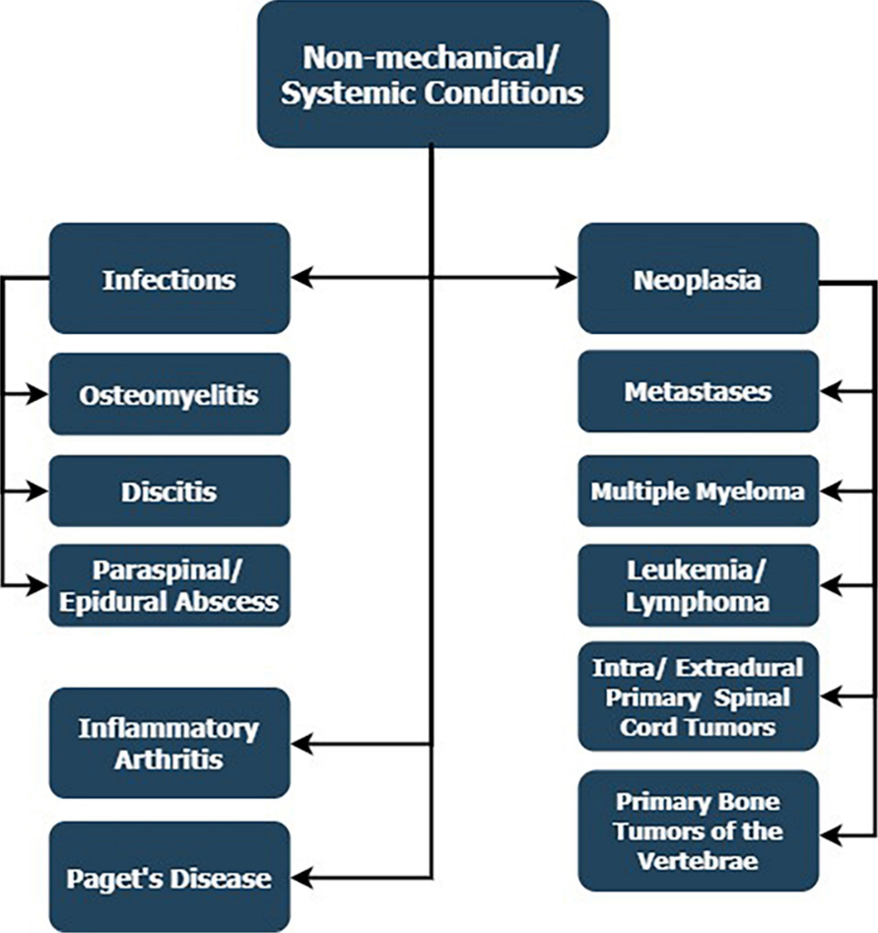

Slide 46
Differentials-Non-Mechanical pain
Infection
Fever/Rigors
Systemically unwell
Intravenous drug use or immunocompromise
Can arise from direct inoculation or spread from another source.
Trauma/Fracture:
Direct or indirect contact with an external force
Thoracic pain
Significant mechanism of injury
Known previous fragility fracture
Systemic steroid use
Structural deformity
Eg : Whiplash injury
Inflammatory – e.g. Ankylosing spondyloarthritis or
Rheumatoid arthritis in Neck
Significant early morning pain and stiffness
(>30mins)
Improves with activity
Often symmetrical distribution
Acute onset
History of inflammatory pathology, psoriasis
Vascular:
Cold limb/Absent pulses
Pulsating abdominal pain. eg AAA
Referred pain:
Visceral organ inflammation can cause referred back pain.
Examples are biliary colic, lung disease, and aortic or vertebral artery pathology.
Cancer
Unremitting pain
Systemic upset
Significant past medical history (e.g. systemic steroids, cancer)
Previous history of malignancy
Night pain
Intractable pain
Weight loss
Anatomic structures of the back can develop primary or secondary malignant lesions
Notes:
https://cks.nice.org.uk/topics/back-pain-low-without-radiculopathy/diagnosis/differential-diagnosis/
https://cks.nice.org.uk/topics/neck-pain-non-specific/diagnosis/differential-diagnosis/
https://pmc.ncbi.nlm.nih.gov/articles/PMC10876847/

Slide 47
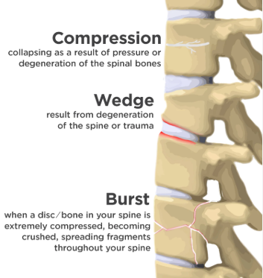
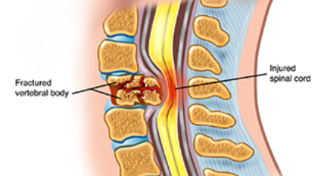
Pathological fracture
Sign and Symptoms:
Midline spinal tenderness; On touch, percussion, or coughing
Stable and Unstable
Fracture Indicators:
Local spinal tenderness
Neurological deficits
Pain with coughing/sneezing
Management
Unstable: Urgent referral to A&E
Stable:
  Refer to osteoporosis clinic
  Start physiotherapy
Traumatic: Injury-related
Pathological:
  Osteoporosis
  Spinal metastasis
Age ≥ 65 years
Serious mechanism of injury:
Fall > 1 meter / > 5 steps
Road traffic accident (RTA)
Neurological signs: Limb weakness, numbness
Additional Risk Factors
Pre-existing spinal issues:
  Osteoporosis
  Long-term steroid use

Slide 48
Osteoporosis
Key Facts:
Osteoporosis and related fractures are a major cause of morbidity in RA patients.
Remain asymptomatic until fracture occurs
~1 in 3 women with RA experience a fracture within 5 years of diagnosis.
Fragility fractures significantly increase both mortality and morbidity.
Diagnosis is based on history of fragility fracture or low bone mineral density which is T score equal or less than 2.5.
Why the Increased Risk?
Reduced mobility
Chronic inflammation
RA treatments – particularly glucocorticoids
Steroid Use in RA:
Steroids greatly elevate fracture risk
Risk exceeds what is expected from changes in bone mineral density alone
Lifestyle Measures for All Patients:
Regular exercise
Increase dietary calcium
Vitamin D supplements
Medication Review:
Minimize steroid dose and duration
Use lowest effective dose
Notes:
https://pmc.ncbi.nlm.nih.gov/articles/PMC10084730/

Slide 49
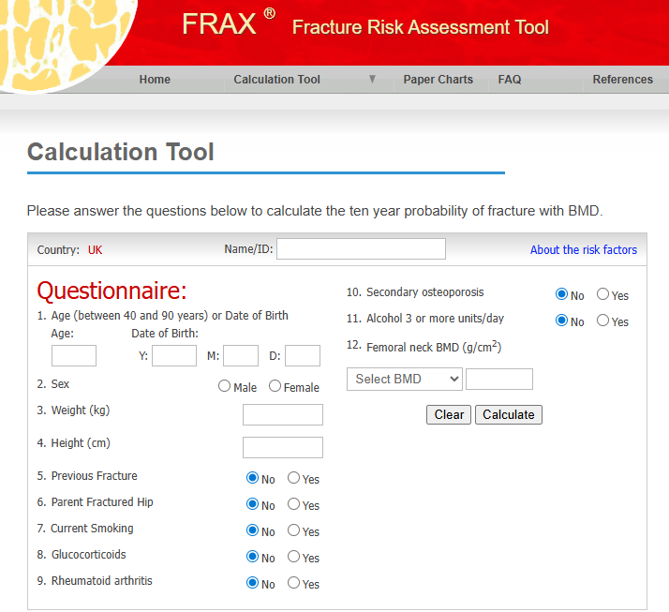
FRAX score: Risk prediction tool
frax.shef.ac.uk/FRAX/tool.aspx?country=1
Notes:
https://fraxplus.org/calculation-tool

Slide 50
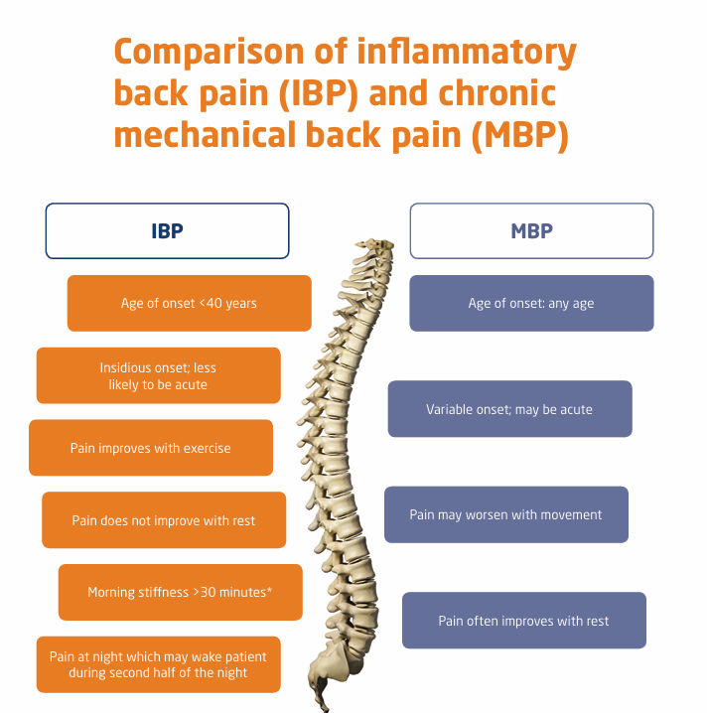
Non-Mechanical Low back pain
Inflammatory back pain
Is a chronic back pain (≥3 months) caused by inflammation in the spine and sacro-iliac joints with insidious onset, morning stiffness, and improvement with exercise but not with rest, often beginning before age 45 and associated with inflammatory markers or HLA-B27 positivity
Non-mechanical low back pain is less common and not directly related to movement or physical stress on the spine's structures.
It can be caused by systemic diseases, infections, tumors, or referred pain from other organs (Donelson, 2007).

Slide 51
Bone metastases and MSCC
Investigations:
Blood tests:
Look for raised alk phos and calcium
Tumour marker may be raised (PSA in prostrate cancer)
Imaging:
Plain film: 46% sensitivity, 32% specificity
Bone scan: increase osteoblast activity. Can not distinguish between mets and other conditions
MRI has sensitivity of 100% and specificity of 88 for bone mets
Treatment:
Analgesics, Radiotherapy, Bisphosphonates, Radiopharmaceutical, Radioablation
In MSCC, Treatment is either radiotherapy to improve pain. To improve neurological function and prevent neurological deterioration, surgical treatment such as decompression, stabilization, vertebroplasty or kyphoplasty.
80% of all bone mets come from breast, lung, kidney and prostrate cancers
Features of bone Mets
Pain: Half of the all bony mets are clinically silent
Pathological fracture
Metastatic Spinal cord compression: Increase back pain, worse when coughing/straining and lying down, radicular pain due to nerve root compression, heaviness or clumsiness in limbs, rapid onset motor or sensory symptoms, weight loss/lumps/cough
Nerve root compression: Shooting, burning, stabbing pain and often dermatomal
Management:
Refer to GP or A&E or oncology team depending on features
Notes:
https://pmc.ncbi.nlm.nih.gov/articles/PMC11052148/
The MSK and Chronic pain update handbook

Slide 52
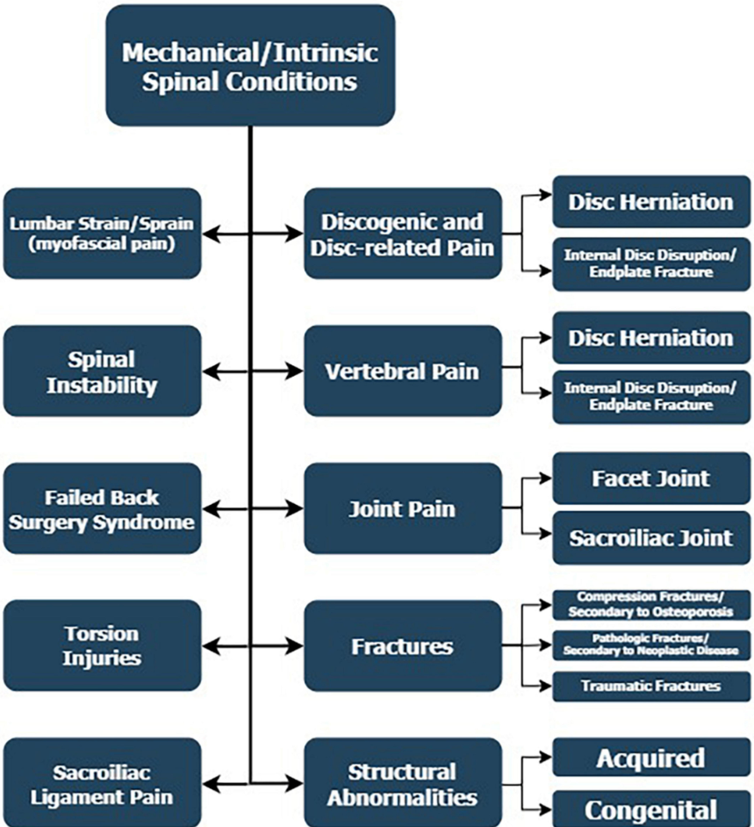

Slide 53
Non-specific or Mechanical low back
Also referred as mechanical, musculoskeletal or simple low back pain
It is the most common type and characterized by pain that varies with physical activity such as bending, lifting, twisting and position such as sitting, standing , walking
Originate from muscles, ligaments, IVDs, or facet joints (McKenzie 1981)
Pain centralizes or Peripheralizes
McKenzie system of mechanical diagnosis and therapy
Provide mechanical diagnosis and treatment
Postural Syndrome – Pain from prolonged poor posture; no movement loss; pain local and relieved by changing position.
Dysfunction Syndrome – Pain from shortened or stretched soft tissues; occurs at end range; movement restricted; pain is consistent and reproducible.
Derangement Syndrome – Pain from disc or joint displacement; may radiate; variable pain and movement loss; symptoms change rapidly with repeated movements

Slide 54
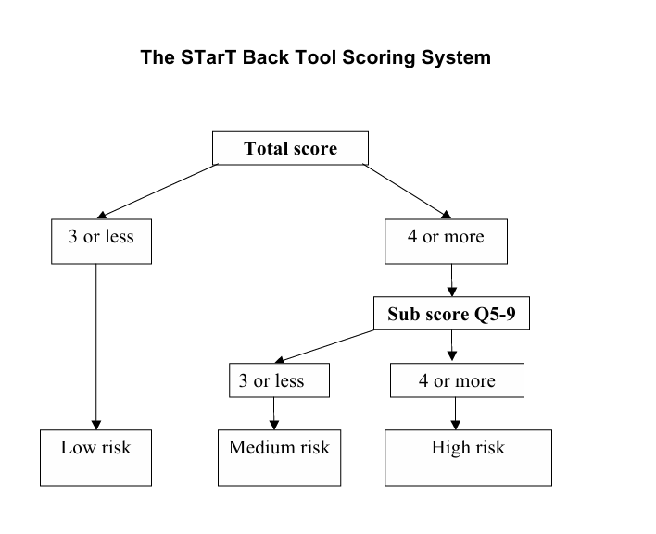
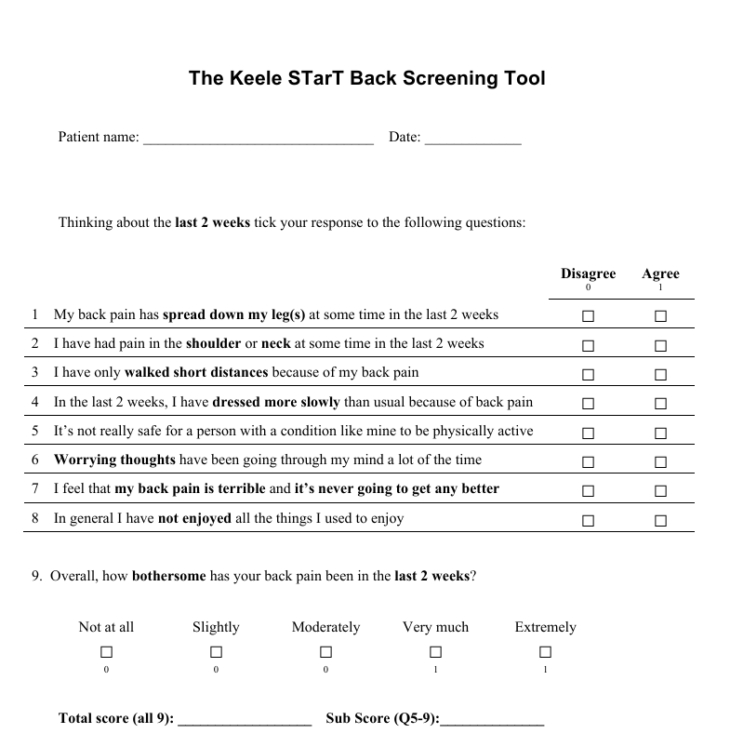
The STarT Back Assessment tool
Low risk: Give self help advice, a back book with information and advice regarding analgesia
Medium risk: Standard physiotherapy treatment
High risk: Physiotherapy +brief psychological intervention

Slide 55
Differential mechanical pain
Mechanical causes e.g. back pain
Provoked by particular activities
Relieved by rest
Acute onset
Disc Prolapse
Spondylolisthesis
Postural:
Spending long hours in an upright position can cause back pain.
Pregnancy and certain occupations can predispose people to postural back pain.
Congenital:
Inborn conditions of the axial skeleton can cause the symptoms.
Examples are kyphoscoliosis and tethered spinal cord.
Psychiatric:
Back pain may also present in patients with chronic pain syndromes and fibromyalgia and other mental health conditions.
Malingering individuals may also claim to have back pain
Symptoms – Discriminators in the History
Osteoarthritis
Typical distribution of joints affected (hands, hips, knees, back, neck)
Pain & stiffness worse on initiating movement and towards the end of the day
Often worse with increased activity
Gradual onset
Intervertebral disk herniation and degenerative disk disease fall into this class
Neural Compromise:
Widespread or multilevel neurological symptoms or signs
Saddle anesthesia
Urinary retention or incontinence
Sphincter disturbance, faecal incontinence
Bilateral referred leg pain
Priapism
Progressive weakness
Notes:
https://cks.nice.org.uk/topics/back-pain-low-without-radiculopathy/diagnosis/differential-diagnosis/
https://cks.nice.org.uk/topics/neck-pain-non-specific/diagnosis/differential-diagnosis/
https://pmc.ncbi.nlm.nih.gov/articles/PMC10876847/

Slide 56
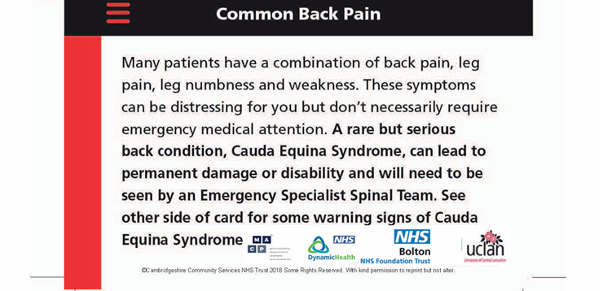
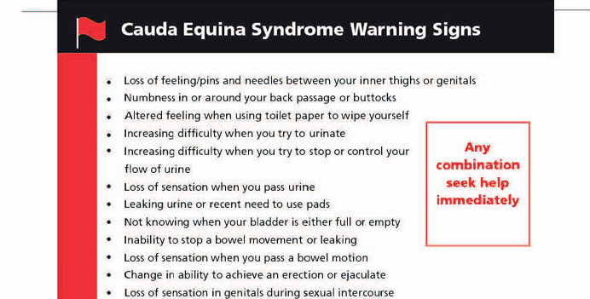
Cauda Equina Syndrome
It is a rare condition caused by compression of the lumbosacral neve roots below the conus medullaris, and is a clinical-radiological diagnosis most commonly made using MRI
The condition affects 1-3 people per 100,000 population in England and there are around 8,000 suspected cases every year.
It is a surgical emergency to prevent a high risk of morbidity
Common symptoms: Lower back pain, sudden onset bilateral motor (such as major motor weakness with knee extension, ankle eversion, or foot dorsiflexion) or sensory symptoms or unilateral symptoms progress to bilateral, bladder or bowel dysfunction, sexual dysfunction and saddle anesthesia
Follow national NICE or GRFIT pathway or local pathway
Refer immediately to A&E if suspected
Document:
– Sign and symptoms
– frequency
– duration
– progression
– time and date of assessment
– time of referral
– person receiving referral
– advice received and from whom
Give clinical summary / proforma to patient if referral accepted
Notes:
https://pmc.ncbi.nlm.nih.gov/articles/PMC10159340/
https://girft-interactivepathways.org.uk/cauda-equina-1/spinal-suspected-cauda-equina-syndrome-2a/

Slide 57
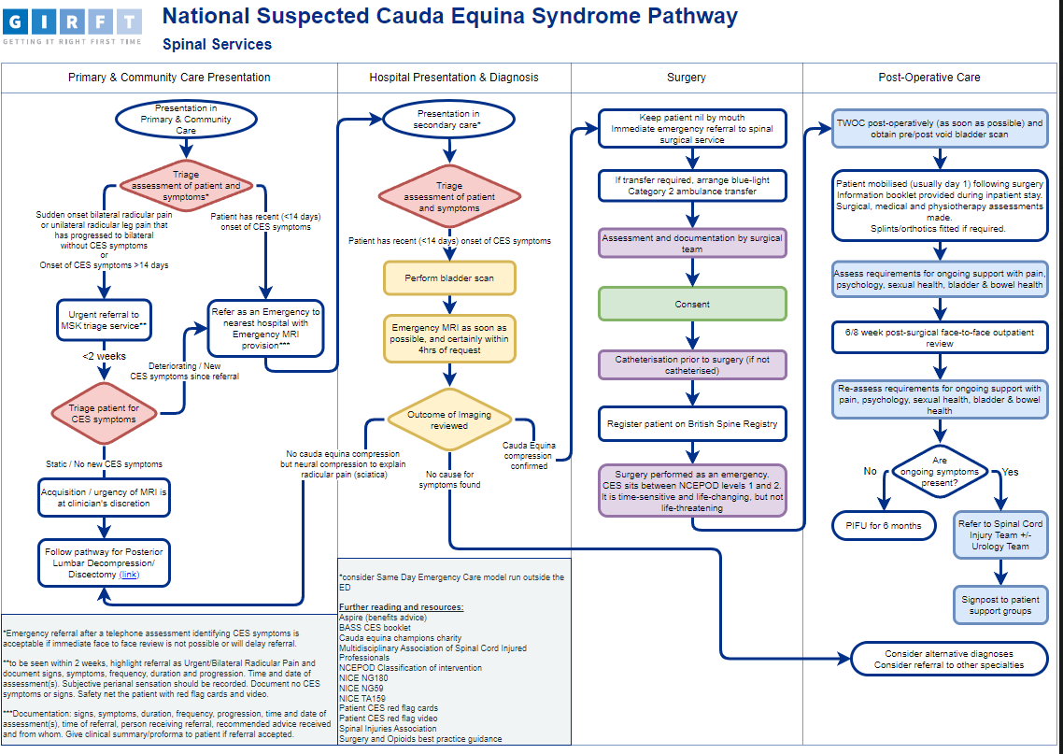
Notes:
https://girft-interactivepathways.org.uk/cauda-equina-1/

Slide 58
1. Radiculopathy/Radicular pain
MSK related Spinal neurology include:
Suspected myelopathy: Patients with bilateral leg pain, arm pain, neck and possibly back pain with loss of dexterity in the hands and altered gait pattern (co-ordination issues)
Suspected radicular pain with signs of radiculopathy, characterized by: Lower/upper limb weakness, back or neck pain respectively, sensory loss or absent reflexes. They may be reported with the degree or progressive nature.
Nerve root (radicular) symptoms and signs are usually single level and unilateral. Usually, limb pain is more severe than neck or low back pain. In the cervical spine, C5/6-C7/T1 are the most common places for nerve root compromise (brachialgia).
In the lumbar spine, L4/5-L5/S1 are the most common places for nerve root compromise (sciatica)
3. Lumbar spine stenosis with lower limb neurological and significant ambulatory deficits: Bilateral leg pain and inability to walk more than short distances (100 yards), eased by sitting down.

Slide 59
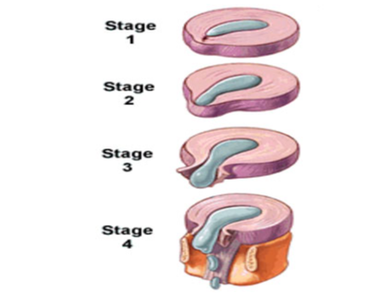
Disc herniation
Refers to the displacement of nucleus pulposus material through annual fibrosus, potentially compressing neural structures
Stage | Description | Symptoms | MRI or pathological fracture
Disc bulge/Degeneration | Early changes in disc, loss of height, Annulus intact but weak | Often asymptomatic or mild back pain | Mild extension of disc margin beyond vertebral body, <3mm
Protrusion | Nucleus pushes into annulus/outer Fibers intact | Local or referred pain, occasional radiculopathy | Focal outpouching of disc
Extrusion | Annular fibres disrupted, NP in epidural space but remains connected | Clear radicular pain, neurological sign possible | Narrow neck with free extension beyond annulus.
Sequestration | NP fragment detaches completely and migrates | Motor or sensory loss, Possible CES or Foot drop | Free fragment seen on MRI, may migrate up and down
Notes:
https://www.thespinejournalonline.com/action/showPdf?pii=S1529-9430%2814%2900409-4

Slide 60
Cervical radiculopathy and myelopathy
 | Cervical radiculopathy | Cervical Myelopathy
 | Sensory symptoms (more common) and lower motor neurone weakness-usually unilateral | Mixed upper and lower motor neurone and sensory –usually bilateral
c5 | Deltoid/Biceps weakness, Reduced biceps reflex | Pyramidal weakness: -Upper limb extensors more than flexors -Lower limb flexors more than extensors Limb hyper reflexia Spasticity Ankle clonus Upgoing plantar Sensory loss (may have a level on trunk) Lhermitte's sign( Electric shock sensation down spine/in to limbs with flexion of extension of neck) Gait disturbance
c6 | Brachioradialis/wrist extensor weakness Thumb paraesthesia Reduce brachioradialis reflex
c7 | Triceps and wrist flexion weakness Paraesthesia in index, middle and ring finger
c8 | Weakness of distal phalanx flexion (unable to keep fingers curled) Little finger paraesthesia

Slide 61
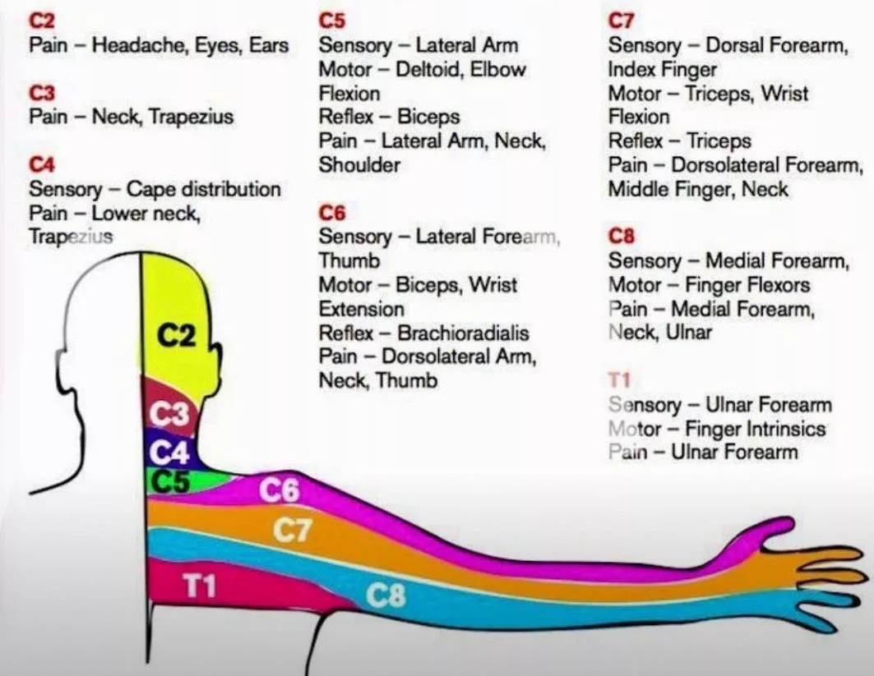
Cervical nerve root

Slide 62
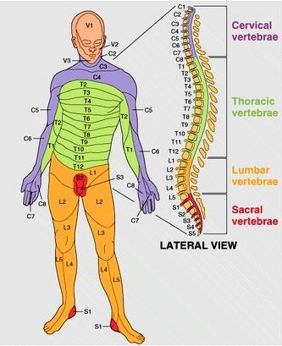
Notes:
1

Slide 63
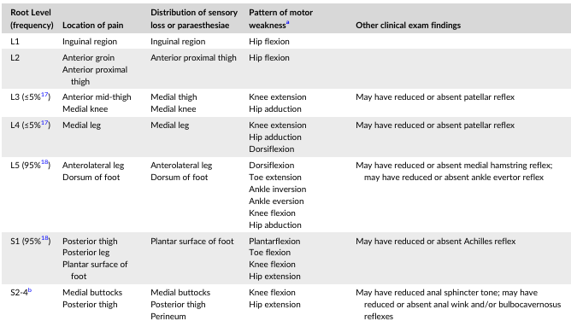
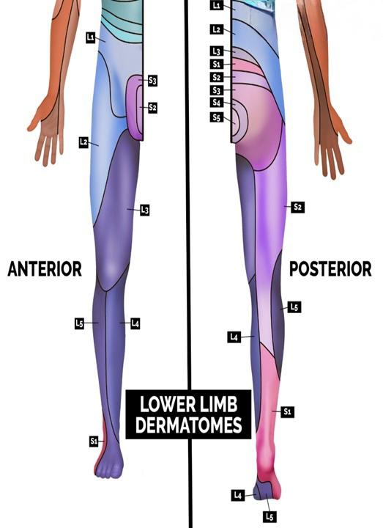
Nerve root level and supply of legs

Slide 64
Referred Pain
Piriformis syndrome - The sciatic nerve passes through the piriformis muscle (a hip external rotator) in less than 10% of the population. Pain distribution is similar to sciatica but tends to be worse during or after exercise. Reflexes, motor and sensory testing are usually normal and nerve stretch tests such as the straight leg raise are negative.
Spinal canal stenosis - Caused by narrowing of the spinal canal or neural foramina producing root ischaemia and neurogenic claudication. Stenosis of the spinal canal is most often caused by a combination of loss of disc space, osteophytes and a hypertrophic ligamentum flavum. Patients are usually aged over 60 and present with spinal claudication – unilateral or bilateral leg pain, +/- back pain, numbness and weakness which develop after the patient walks a predictable distance. Patients often report it is easier to walk uphill rather than down. It is important to rule out peripheral vascular disease as a differential diagnosis.
Following are causes of referred pain:
Central disc protrusion - Bilateral leg pain, gait or sphincter disturbance, saddle anaesthesia – this is a neurosurgical emergency - refer immediately.
Nerve root irritation/compression - There is a dermatomal distribution of pain, numbness or paraesthesia with loss of reflexes or weakness in corrresponding myotomes. It is usually single level. If more than one level is affected, the patient needs urgent assessment. Often, pain in the limbs is greater than pain in the back or neck.
Referred myofascial pain (trapezius, gluteal muscles, paraspinal muscles) - The pattern of pain is often deep or aching, usually involving proximal muscle groups (thighs/shoulders). It doesn’t usually extend to hands or feet. Nerve stretch tests such as straight leg raise are not provocative of pain.

Slide 65
Nerve root pain management
The initial management of patients with single-level nerve root symptoms even with neurological signs is the same as for patients with non-specific back pain:
These patients should be reviewed regularly.
50% of patients will improve within six weeks.
If symptoms are improving but not resolved, then consider a referral to physiotherapy .
If they have progressive neurological signs or uncontrolled pain, they should be referred for urgent MRI and specialist assessment (i.e. within 1-2 weeks).
If nerve root signs and symptoms are not resolving at six weeks, consider an onward referral for MRI scan as these patients may be considered for intervention such as nerve root block or surgery.
There is a difficult balance to strike between not referring patients with symptoms of radiculopathy who are likely to improve with conservative treatment too early, and not waiting too long to refer those who are not improving.

Slide 66
Lumbar spinal stenosis
Narrowing of the spinal canal in the lumbar spine causing compression of spinal nerves, common in adult >60 years
Neurogenic claudication is pain on walking or standing that radiate beyond the spine to the legs and buttocks
Wide based gait
Abnormal Romberg test
Management:
Drugs, physiotherapy main stay of treatment
Surgical options: Decompression, lumbar fusion and infraspinous distraction
History | Characteristic | Score
 | Age:60-70 y | 1
 | Age:>70 | 2
 | No diabetes | 1
 | Neurogenic claudication present | 3
 | Increase symptoms on standing | 2
 | Improvement on bending forward | 3
Examination | Induced by bending forward | -1
 | Induced by bending backward | 3
 | Peripheral arterial circulation good | 3
 | Abnormal ankle reflex | 1
 | SLR reproduce pain | -2
A score of 7 or > support the diagnosis of Spinal stenosis
Notes:
Interpretation:
Positive Romberg Sign:
Patient becomes unsteady or falls only when eyes are closed → Suggests sensory ataxia (loss of proprioception).
Negative Romberg Sign:
Patient maintains balance with eyes closed → Normal proprioceptive function.
Instability with eyes open and closed:
Suggests cerebellar ataxia (not proprioceptive).
66

Slide 67

Break

Slide 68
Visceral Disease or referred pain
Spinal Masqueraders
Conditions that mimic lower back pain
Pain is non-mechanical (not from spine/muscles)
Caused by referred pain from visceral organs.
Examples of Spinal Masqueraders:
Renal (e.g., kidney stones, infections)
Pancreatic disease
Aortic aneurysm
Pelvic conditions (e.g., endometriosis)
GI causes (e.g., ulcers, colitis)
Key Clue:
Pain not relieved by rest or position changes

Slide 69
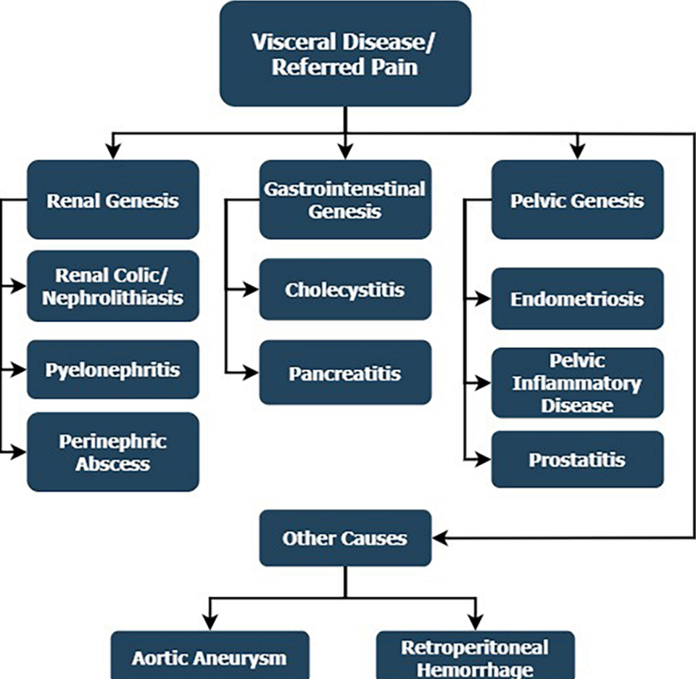

Slide 70
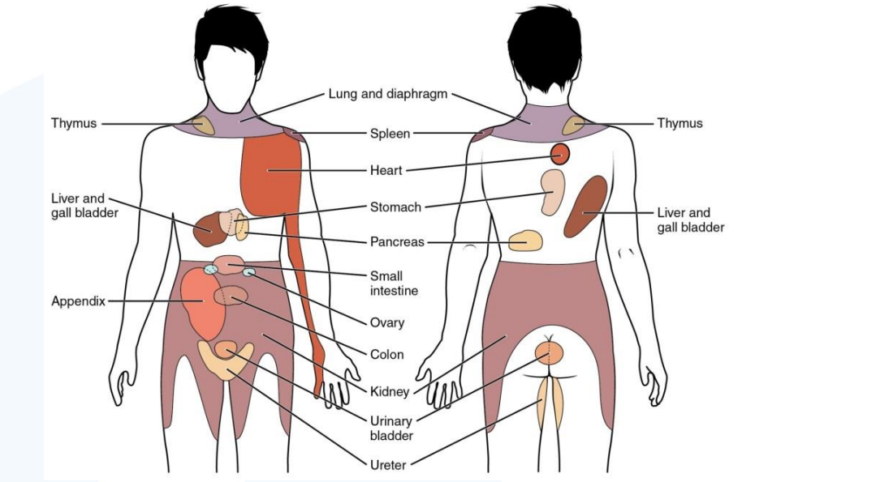

Slide 71
Visceral or referral Pain
Acute Pancreatitis | Can cause thoracolumbar back pain. Often triggered by binge drinking or gallstones.
Duodenal Ulcers | Vague abdominal and back pain. Pain often worsens with hunger or with high acid levels in the stomach. Pain often lessens with use of antacids.
Urinary Tract Infections | Pain is often across the back and radiates to the groin. Patients often report dysuria, urgency and frequency. If the infection affects the renal system the pain is often more severe and can radiate to the upper back. Fever may also be present.

Slide 72
Contd
Prostatitis | Characterised by fever and a vague aching pain in the lower back that radiates into the rectum.
Gallstones | Patients can experience severe pain in the abdominal or back area when fatty meals are consumed. Pain is colicky (sharp episodic pain occurring at intervals) with periods of improvement and relief.
Kidney Stones | Common in middle aged men and women. Interruption of urine flow results in severe pain that may radiate from the thoracolumbar region around to the lower abdomen and groin.
Visceral Cancer | Vague low back pain can be the first sign of visceral cancer. Pain is often not relieved by rest and may be most intense at night. Pain progresses regardless of modification of activities and use of medication.

Slide 73
Abdominal Aortic Aneurysm
Abdominal Aortic Aneurysm Immediate action – triage immediately
Back pain that is acute and severe
Pain can radiate to the chest
Rest does not always ease the pain
Palpation of the back or back movements do not affect the pain
Symptoms may be worse at night
A loss of lower extremity pulses
The GP should document that they have palpated the abdomen (with no pain) to help rule out an AAA

Slide 74
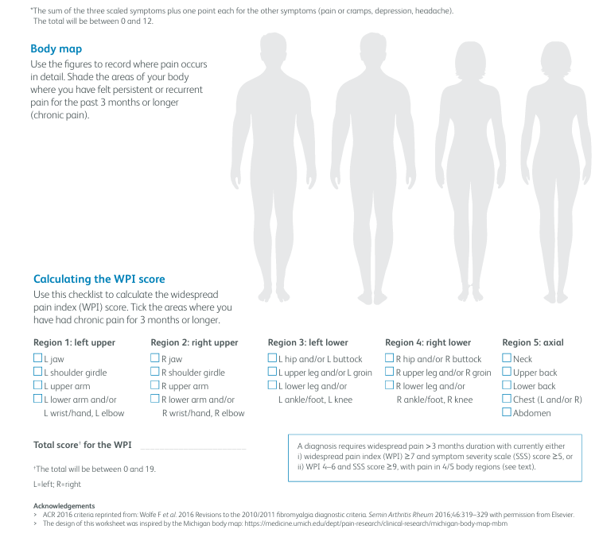
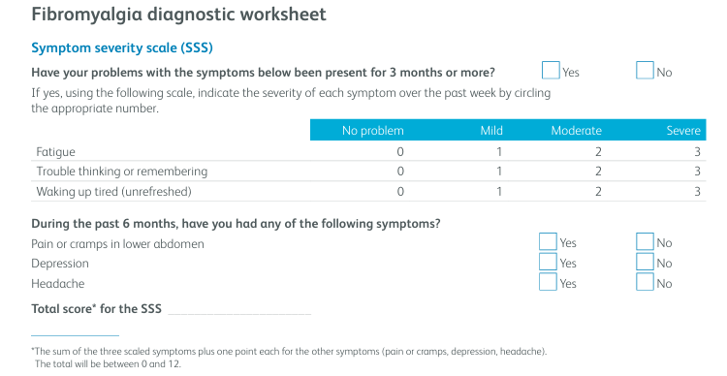
Fibromyalgia

Slide 75
Investigations
Blood test:
Inflammatory arthritis or myeloma or metabolic disease or rule out for fibromyalgia or UTI
FBC, LFT, RFT, TFTs, Hb1AC, Cholesterol, Vitamin D, Vitamin B12, folic acid, Iron
Inflammatory markers like ESR, CRP, CK
Connective tissue or autoimmune inflammatory markers like ANA, ENA, ds DNA antibody, Anti CCP, Rh factor, HLA B 27
Immunoglobulins such as Serum protein and Urine Protein Electrophoresis for myeloma
Radiological investigations:
X-ray
MRI
CT scan
Bone Density Scan

Slide 76




Slide 77

Exercise regularly
Stay active
Lift correctly
Maintain a healthy lifestyle
Use pain relief when needed
Adapt your work environment
Use a rucksack-avoid one sided bag
Maintain good posture Sit properly
Communicate at work

Slide 78
Management

Slide 79
Shared Decision making
For clinician
Encouraging people to express what matters to them
Using plain language, avoiding jargon
Explaining risks, benefits, and consequences of options
Involving families/carers in decision
Definition: It is a collaborative process that involves a person and their healthcare professional working together to reach a joint decision about care
Communication:
For Patient
What are my options
What are the risks and benefits
How can we decide together
Communicating Risks & Benefits
Personalize risk information based on what matters to the person.
Use clear, numerical data with visual aids (e.g., icon arrays, pictographs).
Communicate using:
Absolute risks (“1 in 1,000 to 2 in 1,000”)
Natural frequencies (10 in 100 instead of 10%)
Positive and negative framing (“97 succeed, 3 fail”)
Three-talk model
A practical model based on following choice, option and decision talk stages during the consultation.
The model has 3 steps:
• introducing choice
• describing options, often by integrating the use of patient decision support
• helping people explore their preferences and make decisions.
Notes:
https://www.nice.org.uk/guidance/ng197/resources/shared-decision-making-pdf-66142087186885

Slide 80
Management Plan
Next steps for management
Are you clear on your diagnosis?
Are further investigations necessary?
Is analgesia required?
Given the patient adequate advice including signposting to further information?
Are you confident to provide treatment ? If not what local pathways exist for further assessment and management?
Do guidelines exist to help you with evidence-based management decisions?
Are shared decision-making tools available to help support patients to make informed decisions about their care (see resources)?
What follow up plans are in place? This is particularly important for patients with who have any red flag symptoms or if you have identified psychosocial barriers to improvement
If time off work is required, how can you support rapid return to work?

Slide 81
Goal of treatment
Acute phase
Decrease pain, inflammation and muscle spasm
Promote healing of tissue
Increase pain free range of motion
Regain soft tissue extensibility
Regain neuromuscular control
Initiate postural education
Allow progression to functional phase
Functional phase
Symptoms fully resolved or significantly reduced
Pain-free and complete spinal range of motion restored
Upper and lower kinetic chains fully reintegrated
Respiratory function normalized
Spinal and upper/lower quadrant strength and neuromuscular control reestablished
Notes:
Dutton Orthopaedic 5th edition

Slide 82
Management
Invasive treatment
1. Non-surgical intervention
Spinal injections
Radiofrequency Denervation
Epidural
2. Surgical management
Spinal decompression
Spinal Fusion
Disc replacement
Non-Invasive treatment
Non-pharmacological intervention
Self management: Advice, re assurance, encouragement to continue ADLs, heat or cold therapy, Exercises therapy: biomechanical, aerobic, mind–body or a combination of approaches
Manual therapy:
Traction
Spinal manipulation,
joint mobilisation
soft tissue mobilisation
Orthotics or brace
Acupuncture
Electrotherapies
Psychological therapy: CBT
Combined physical and psychological program
Return to work programmes
Post Surgical rehabilitation
2.Pharmacological intervention
Over the counter pain medication
Analgesics
NSAIDs
Neuropathic pain medication
Notes:
Recommendations | Low back pain and sciatica in over 16s: assessment and management | Guidance | NICE

Slide 83

Menu Options
Non-Invasive Approach
Self management
Physiotherapy
Pharmacology management

Slide 84


Slide 85

Notes:
Almeida, M., Saragiotto, B., Richards, B. and Maher, C.G. (2018). Primary care management of non-specific low back pain: key messages from recent clinical guidelines. Medical Journal of Australia, 208(6), pp.272–275. doi:https://doi.org/10.5694/mja17.01152.

Slide 86
Self care or self management
Self care is the ability of individuals, families and communities to promote health, prevent disease, maintain health, and cope with illness and disability with or without the support of a health worker.
Self management is related specifically to long term condition
Promoting self care is essential for optimal management of long-term condition
It is win-win, improving patient’s quality of life and reducing demand
When medical treatment is optimized, stop offering tests and interventions and move on
Increase ability to self care | May decrease ability to self care
Supportive, non-judgemental consultation Coaching interview style that promote change Understanding the patient’s psychosocial framework Balancing pathological explanation with helpful information Active treatments | Being on waiting list Biomedical or pathological explanation of long-term conditions e.g. wear and tear arthritis Passive treatment A belief that medicine still has ‘more to offer’
Notes:
Self care: https://www.who.int/health-topics/self-care#tab=tab_1
https://newhamgpvts.org.uk/wp-content/uploads/2019/10/selfcareandselfmanagementintroduction1570462267582.pdf

Slide 87
Promoting behaviour change
Can make a real difference to patient in changing their life style
Motivational interviewing: Evidence-based intervention that helps to support health behaviour change
https://www.youtube.com/watch?v=bTRRNWrwRCo&t=149s
Motivational interview Vs brief intervention:
-Where time is tight, continue to offer Brief intervention
Notes:
https://www.physio-pedia.com/Motivational_Interviewing
https://livewellwithpain.co.uk/resources-for-people-with-pain/ten-footsteps-to-living-well-with-pain/

Slide 88
Physiological effects of exercise
Muscle strengthening:
Improve spinal stability and posture
Reduce mechanical stress on spinal structures
Neural plasticity and central pain modulation
Exercise increases β-endorphin release → binds to opioid receptors → Enhances neuroplastic change and reducing pain perception
Enhances serotonergic and noradrenergic activity and activate descending inhibitory pathways to modulate pain
Increase growth factors → supports neuroplasticity and pain modulation.
Decrease pro-inflammatory cytokines (IL-6, TNF-α) and Increase anti-inflammatory cytokines → reduces sensitization
Improve circulation
Enhance oxygen and nutrient delivery to spinal tissue
Promote removal of metabolic waste products
Tissue healing and improve pain:
Enhance cellular repair and regeneration
Support remodelling of injured soft tissue
Exercise increases β-endorphin release → binds to opioid receptors → reduces pain perception.
Notes:
https://pubmed.ncbi.nlm.nih.gov/38662515/

Slide 89
Live well with pain: the 10 foot-steps
Building knowledge
Acceptance
Pacing
Goal setting and rewards
Getting fit and staying active
Managing mood
Sleep well more often
Healthy eating, relationship and coping with work
Relaxation and mindfulness
Manging set backs

Slide 90


Notes:
Interventions for the Management of Acute and Chronic Low Back Pain: Revision 2021

Slide 91
Exercise Therapy
Essential to improve muscle strength, endurance, motor control, flexibility and stabilisation
ROM exercises, Isometric and resistance exercises
William flexion exercises
McKenzie Approach
Spinal Stabilization exercise
Stretching exercise
Aerobic exercises

Slide 92
Physical exercises
Lack of physical activity and prolonged sedentary behavior can exacerbate musculoskeletal pain including spinal pain and disability.
Engaging in regular exercise is a safe, effective, and affordable treatment that offers benefits beyond simply reducing pain.
It enhances sleep quality, emotional health, daily functioning, and overall quality of life.
Multicomponent exercise programs—including aerobic, strength, flexibility, and balance training—performed at light to moderate intensity, 2–3 times weekly, yield the best results.
Exercise should be customized to each individual’s needs and reinforced with education and strategies to promote adherence to maintain long-term benefits.
Notes:
The Role of Physical Exercise in Chronic Musculoskeletal Pain: Best Medicine—A Narrative Review – PMC
UK Chief Medical Officers' Physical Activity Guidelines

Slide 93
Manual Therapy
Mechanism:
Biomechanical: tissue mobility, fluid dynamics
Neurological: neural conduction, cortical activation
Neurovascular: sympathetic and circulatory responses
Neurotransmitter/Neuropeptide: serotonin, β-endorphin release
Neuromuscular: muscle tone, recruitment changes
Neuroendocrine: cortisol and hormonal responses
Neuroimmune: inflammatory and anti-inflammatory mediator release
Manual Therapy (MT) is a type of force-based manipulation which has been defined as “passive application of mechanical force to the outside of the body with therapeutic intent, often as part of pain management care (e.g., low-back pain), rehabilitation care, or general wellness and disease prevention
MT provides efficacy/effectiveness in improving range of motion, reducing disability, improving function and modulating pain
Note: Although manual therapy (MT) has demonstrated effectiveness in managing conditions such as pain, the current literature does not adequately explain the underlying mechanisms driving its therapeutic effects
Notes:
https://journals.plos.org/plosone/article?id=10.1371/journal.pone.0319586

Slide 94
Manul therapy approaches
Approach | Assessment Focus | Key Treatment Technique | Core Principle
Cyriax | Selective Tissue Tension Tests (contractile vs non-contractile) | Deep transverse friction, passive movements, active exercises | Pain has a source; treatment must reach and benefit the lesion
Kaltenborn | Arthrokinematic joint play, accessory movements | Traction, glide, compression mobilizations (Grades I–III) | Restore normal joint mechanics through accessory motion correction
Maitland | Symptom reproduction with movement | Graded oscillatory mobilizations & manipulations (Grades I–V) | Patient-centered; reduce pain, restore mobility, normalize tone
Mulligan | Functional movement + symptom-free joint correction | Mobilization with Movement (MWM), SNAGs (active + passive techniques) | Active participation + painless correction enhances recovery
McKenzie (MDT) | Mechanical diagnosis via repeated movements | Self-directed repeated movements, posture correction | Centralize symptoms; empower patient self-management
Paris & Others | Joint-specific mobility restrictions | Joint mobilization, manipulation, posture correction | Correct mobility impairments to reduce pain and restore function
Osteopathic Approach | Structural imbalances, tissue mobility, posture | Manual therapy (manipulation, mobilization), soft tissue work | Body’s structure-function relationship; restore balance to heal
Movement System Impairment (MSI) | Faulty movement patterns, posture, muscle imbalances | Movement retraining, motor control exercises | Correct faulty movement patterns to reduce pain and dysfunction
Treatment-Based Classification (TBC) | Symptom behavior, functional limitations, clinical tests | Specific exercises (mobilization, stabilization, directional preference) | Classify patients for targeted, evidence-based treatment
Notes:
Chevan, J. and Clapis, P.A. (2013). Physical therapy management of low back pain : a case-based approach. Burlington, Ma: Jones & Bartlett Learning.

Slide 95
Manual therapies-Nice Guidelines
Acupuncture or electrotherapies: Do not offer acupuncture or electrotherapies such as ultrasound, PENS, TENS or IFTs for managing back pain
Do not offer traction for managing back pain with or without sciatica
Consider manual therapy (spinal manipulation, mobilisation or soft tissue techniques such as massage) as part of treatment package including exercises with or without psychological therapy
Psychological therapy: Consider psychological therapist using cognitive behavioural approach for managing back as part of a treatment package including exercises, with or with out manual therapy (spinal manipulation, mobilisation or soft tissue technique such as massage)
Notes:
NICE guidelines

Slide 96
Neurodynamic
Study of the mechanics and physiology of the nervous system
Evaluates the length and mobility of various components of the nervous system
Mobilization of the nervous system is an approach to physical treatment of pain
Three mechanism play important role in adaptability:
Elongation of the nerve against elastic forces. Nerve slide 2cm in daily movement
Longitudinal movement of the nerve trunk
An increase and decrease of tissue relaxation at the level of the nerve trunk
Neural tissue responds to trauma in the same as ligament and tendon by evoking the cascade of inflammatory process
Stretching program for the sciatic nerve
Stretches for the upper extremity nerves
Notes:
https://www.physio-pedia.com/Neurodynamic_Assessment#Upper_limb_tension_test_1_.28median_nerve_bias.29

Slide 97
Pharmacological management
Pharmacological intervention is recommended when first line of treatment is inadequate
Non opioids analgesics: Paracetamol also called acetaminophen, aspirin
Opioids analgesics: Commonly prescribed drugs in spinal pain, effective in pain relief and improve function. Weak (codeine phosphate, dihydrocodeine, Meptazinol) and strong Opioids( Morphine, tramadol, oxycodone hydrocholoride, Pethidine hydrocholoride, Fentanyl).
Non -Steroidal Anti-inflammatory drugs (NSAIDS): Ibuprofen, Naproxen
Myorelaxant drugs: Ability to reduce tension or relax muscles. Eg: Baclofen, methocarbamol, tizanidine. Mainly used in combination with paracetamol and NSAIDs
Anti Epileptic drugs: First line therapy in the treatment of neuropathic pain such as Gabapentin and pregabalin. Play critical role in radicular pain or neurogenic claudication
Anti depressant: Back pain with concomitant depression eg duloxetine
Other Drugs: Corticosteroids oral or intravenous (not effective), Tropical capsaicin for less than 3 months
Notes:
https://pmc.ncbi.nlm.nih.gov/articles/PMC8088811/
https://bnf.nice.org.uk/treatment-summaries/analgesics/#non-opioid-analgesics-and-compound-analgesic-preparations

Slide 98

Pharmacological management
Consider weak opioids with or without sciatica, Do not offer paracetamol alone for managing low back pain
Do not routinely offer opioids for managing acute low back pain (see recommendation
If already taking explain the risk
If prescribing NSAIDs for sciatica consider GI, Liver and cardio-rental toxicity use the lowest effective for the shortest possible time
If NSAID is contraindicated, not tolerated, or ineffective consider the short-term use of codeine with or without sciatica
Managing mild to moderate pan
Notes:
https://cks.nice.org.uk/topics/analgesia-mild-to-moderate-pain/

Slide 99
If prescribing NSAIDs for sciatica
Take into account potential differences in gastrointestinal, liver and cardio-renal toxicity, and the person's risk factors, including age
Think about appropriate clinical assessment, ongoing monitoring of risk factors, and the use of gastroprotective treatment
Use the lowest effective dose for the shortest possible period of time

Slide 100
Pharmacological management: NICE guidelines
Do not offer gabapentinoids, other antiepileptics, oral corticosteroids or benzodiazepines for sciatica as there is no overall evidence of benefit and there is evidence of harm
Do not offer opioids for managing chronic sciatica
As part of shared decision making about whether to stop opioids, gabapentinoids or benzodiazepines for sciatica, discuss the problems associated with withdrawal with the person
Be aware of the risk of harms and limited evidence of benefit from the use of non-steroidal anti-inflammatory drugs (NSAIDs) in sciatica.

Slide 101
Invasive or surgical management
Indications for referral to a spinal surgeon
Red flags
Back pain persisting for 6 months despite conservative treatment
Persistent radicular/leg pain (>3 months)

Slide 102
Invasive therapy
Injection therapy
Temporary measures but useful in acute exacerbation of back pain management
Temporarily supress the local inflammatory process
Indication:
Failed conservative approach
1st line of invasive approach
Facet joint injection: Targeted for back pain
Epidural and Nerve root injection: Targeted for Neurological or radicular pain, symptoms secondary to spinal and nerve root canal stenosis
4. Sometimes patients unresponsive to one injection benefit from another site.
5. If relief lasts less than six weeks, repeat injections pose more risk than benefit
6. Patient can return to work as soon as they feel able to
Notes:
https://www.asianspinejournal.org/upload/pdf/asj-9-645.pdf

Slide 103
Non-surgical invasive interventions ( Nice Guidelines)
Epidural injections
Consider
Epidural injection of local anaesthetics +steroid
For : acute and severe Sciatica
Do not offer:
Spinal injections for general low back pain
Epidural injection for neurogenic claudication in people with central spinal canal stenosis
Radiofrequency Denervation
Refer for RFD assessment if:
Chronic low back pain AND Non-surgical treatments have failed AND Pain likely from structures supplied by the medial branch nerve AND Moderate to severe localised back pain
Perform RFD
Only after a positive response to a diagnostic medial branch block
Do NOT offer imaging of facet joints as a prerequisite for RFD
Do not offer:
Spinal injections for general low back pain
Epidural injection for neurogenic claudication in people with central spinal canal stenosis
Notes:
NICE Guidelines

Slide 104
Surgical Management
Total Disc Arthroplasty:
Used to avoid the problems of adjacent level disease by preserving motion at the level
Pain relief due to excision of the painful disc and restoration or improvement of load transfer
Need larger exposure to front of the spine, longer recovery and higher risk of complication
4-7 days hospital stay
6 weeks away from work, avoid prolong sitting and heavy lifting
Non fusion stabilization:
Various devices are used to prevent further disc degeneration
Unpredictable efficacy
Average hospital stay of 2-4 days
Must avoid heavy lifting for at least 6 weeks
Indication
In early DDD when ≥50% of disc height remains.
After discectomy for large or recurrent herniations.
In adjacent segment degeneration following fusion.
For degenerative spondylolisthesis or spinal stenosis in selected cases.
When osteoporosis or age makes fusion less suitable
Facet arthroplasty/Face replacement:
To restore normal motion and provide stabilization of spinal segment through replacement of facet ( following facetectomy and neural decompression)
For the treatment of symptomatic facet joint arthritis
Novel procedure but long term result unknown
Allow movement to be preserved
Not widely performed
Fusion:
Symptomatic lumbar DDD
Two vertebrae fuse which act as a solid bone
Gold standard treatment for back pain
Aim to fuse arthritis joint
No heavy lifting for 3 month

Slide 105
Surgical management contd…
Minimally invasive fusion:
Small incision, faster return to daily activities and 2-4 days hospital stay
Includes: Extreme lateral interbody fusion and axial lumbar interbody fusion
No heavy lifting for 3 months
Can return to desk based activities after 2 week or once pain reduces
Endoscopic surgery:
Minimally invasive approach using endoscope
Bridge the gap between invasive temporary technique of pain management and traditional open decompression with or without fusion
Indication: Disc herniation or discogenic pain, spinal stenosis, radiculopathy, DDD
Same day discharge, shorter recovery
Transforaminal, interlaminal approach, cervical endoscopic approach
Contraindication: severe instability, infection or large deformity requiring fusion
Notes:
https://pmc.ncbi.nlm.nih.gov/articles/PMC10080412/

Slide 106
Surgical interventions-Nice Guidelines
Referral for surgical opinion:
Do NOT let the following factors influence the decision to refer a person for surgical evaluation for sciatica:
Body Mass Index (BMI)
Smoking status
Psychological distress
1. Spinal Decompression: Aims to relieve nerve root compression
Consider for sciatica or neurogenic claudication due to:
  Herniated disc and Spinal stenosis
2. Spinal Fusion: Involves joining two or more vertebrae to eliminate motion
Consider only for:
  Spinal instability and Mechanical back pain with confirmed structural cause
3. Disc Replacement: Alternative to fusion in selective cases
Preserves spinal motion
Consider in younger patients with isolated discogenic pain

Slide 107
Post Surgical rehabilitation
Timing of rehabilitation is crucial
Ambulation within 8h reduce complication rate, shorter hospital stays, lower hospital re admission and lower urinary retention rate
Phase I and II : To manage pain and inflammation, restore nerve root mobility, begin re stabilisation and re conditioning, improve soft tissue mobility
Phase III: To return to work with modified duties while independently progressing through a structured exercise, stabilization, and cardiovascular program—focusing on proper technique, gradual strengthening, and functional improvement rather than pain levels.
Phase IV: Full restoration of pre-injury function by independently continuing their conditioning and stabilization program, and progressing to activity-specific strength, agility, and sport drills tailored to their goals.
Notes:
https://www.physio-pedia.com/Lumbar_Fusion_Rehabilitation
https://ejns.springeropen.com/articles/10.1186/s41984-024-00270-z?utm_source=chatgpt.com

Slide 108



Overview of inerventins endorsed for non-specific low back pain in evidence –based clinical practice Guidelines (Danish, US and UK guidelines
Notes:
https://www.thelancet.com/journals/lancet/article/PIIS0140-6736(18)30489-6/fulltext

Slide 109
Prognosis
Most people with non‑specific low back pain recover within a few weeks, making it a self‑limiting condition
Recurrences are common, and many experience repeated acute‑on‑chronic episodes
The median recovery time was 58 days for pain and 31 days for function, with 72% fully recovered by 12 months
Complication
Impact on daily activities including Work
Study
Leisures
Sleep
Depression
Anxiety,
Increase risk of falls
Chronic pain

Slide 110



Notes:
https://bjsm-bmj-com.uniessexlib.idm.oclc.org/content/bjsports/54/12/698.full.pdf

Slide 111
Tips for healthy back
Exercise regularly
Stay active
Lift correctly
Maintain a healthy lifestyle
Use pain relief when needed
Adapt your work environment
Use a rucksack-avoid one sided bag
Maintain good posture Sit properly
Use chair with back rest and sit with your feet flat on the floor, change sitting position regularly
Communicate at work
Notes:
https://backcare.org.uk/wp-content/uploads/2021/02/705-Top-10-Tips-for-Back-Pain.pdf

Slide 112
Safety netting
Vital component of healthcare provision
Receiving increased attention worldwide
1-2% consultation may lead to harm in primary care
Process of advising patients what to do if their condition fails to improve, worsens, or new symptoms appear
Helps to manage diagnostic uncertainty
Effective safety netting include clear advice, written or verbal, with specific warning signs and follow up plans
Notes:
https://pmc.ncbi.nlm.nih.gov/articles/PMC6301356/?utm_source=chatgpt.com

Slide 113
Outcome measures
It is a tool used to assess a patient’s current status
It provide a score, an interpretation of results and risk categorization as times
Common outcome measures:
Function-Oswestry Disability index
Pain-Visual Analogue Scale, Numeric pain Rating Scale, McGill pain questionnaire
Psychosocial: Fear Avoidance Beliefs Questionnaire

Slide 114
Take-Home Messages
Back pain is common but requires careful assessment to identify serious or treatable causes.
Differentiate between mechanical, non-mechanical, inflammatory, radicular, and visceral sources.
Red flags (e.g. bowel or bladder dysfunction, weight loss, fever, night pain) must prompt further investigation for conditions like cancer or infection or CES.
Sciatica and radiculopathy often involve nerve root irritation – assess with focused history and special tests.
Most mechanical back pain improves with activity, education, and reassurance.
Multidisciplinary management – including physiotherapy, medication, and lifestyle – is key to optimal outcomes.
Always consider the patient’s function, not just their pain.

Slide 115
Reference list
Abrahams, S. (2014). Musculoskeletal Medicine in Primary Care. Xlibris Corporation.
Almeida, M., Saragiotto, B., Richards, B. and Maher, C.G. (2018). Primary care management of non-specific low back pain: key messages from recent clinical guidelines. Medical Journal of Australia, 208(6), pp.272–275. doi:https://doi.org/10.5694/mja17.01152.
Atkins, E., Kerr, J. and Goodlad, E. (2015). A Practical Approach to Musculoskeletal Medicine E-Book. Elsevier Health Sciences.
Atkins, E., Kerr, J. and Goodlad, E. (2016). A Practical Approach to Musculoskeletal Medicine : Assessment, Diagnosis, Treatment. Edinburgh: Elsevier.
Baliga, S., Treon, K. and Craig, N.J.A. (2015). Low Back Pain: Current Surgical Approaches. Asian Spine Journal, 9(4), p.645. doi:https://doi.org/10.4184/asj.2015.9.4.645.
Bateman, E.A., Fortin, C.D. and Guo, M. (2024). Musculoskeletal mimics of lumbosacral radiculopathy. Muscle & nerve, 71(5). doi:https://doi.org/10.1002/mus.28106.
Biso, G.M.N.R. and Munakomi, S. (2020). [Figure, Seddon and Sunderland classification of...]. [online] www.ncbi.nlm.nih.gov. Available at: https://www.ncbi.nlm.nih.gov/books/NBK557746/figure/article-25766.image.f1/.
Bresolin, N., Sartori, L., Drago, G., Pastorello, G., Gallinaro, P., Jacopo Del Verme, Zanata, R. and Enrico Giordan (2024). Systematic Review and Meta-Analysis on Optimal Timing of Surgery for Acute Symptomatic Metastatic Spinal Cord Compression. Medicina, 60(4), pp.631–631. doi:https://doi.org/10.3390/medicina60040631.
Chevan, J. and Clapis, P.A. (2013). Physical therapy management of low back pain : a case-based approach. Burlington, Ma: Jones & Bartlett Learning.
De la Corte-Rodriguez, H., Roman-Belmonte, J.M., Resino-Luis, C., Madrid-Gonzalez, J. and Rodriguez-Merchan, E.C. (2024). The Role of Physical Exercise in Chronic Musculoskeletal Pain: Best Medicine—A Narrative Review. Healthcare, [online] 12(2), p.242. doi:https://doi.org/10.3390/healthcare12020242.
Dudley, P. (2023). Pain Pathways. [online] TeachMePhysiology. Available at: https://teachmephysiology.com/nervous-system/sensory-system/pain-pathway/.
Dutton, M. (2020). Dutton’s orthopaedic examination, evaluation, and intervention. 5th ed. New York: Mcgraw Hill Education.
Fardon, D.F., Williams, A.L., Dohring, E.J., Murtagh, F.R., Gabriel Rothman, S.L. and Sze, G.K. (2014). Lumbar disc nomenclature: version 2.0. The Spine Journal, 14(11), pp.2525–2545. doi:https://doi.org/10.1016/j.spinee.2014.04.022.
Ferdinandov, D., Yankov, D. and Trandzhiev, M. (2024). Common differential diagnosis of low back pain in contemporary medical practice: a narrative review. Frontiers in Medicine, 11. doi:https://doi.org/10.3389/fmed.2024.1366514.
Finucane, L.M., Downie, A., Mercer, C., Greenhalgh, S.M., Boissonnault, W.G., Pool-Goudzwaard, A.L., Beneciuk, J.M., Leech, R.L. and Selfe, J. (2020). International Framework for Red Flags for Potential Serious Spinal Pathologies. Journal of Orthopaedic & Sports Physical Therapy, [online] 50(7), pp.350–372. doi:https://doi.org/10.2519/jospt.2020.9971.
Ford, J., Thomas, F., Byng, R. and McCabe, R. (2020). Use of the patient health questionnaire (PHQ-9) in practice: Interactions between patients and physicians. Qualitative Health Research, [online] 30(13), pp.2146–2159. doi:https://doi.org/10.1177/1049732320924625.

Slide 116
Foster, N.E., Anema, J.R., Cherkin, D., Chou, R., Cohen, S.P., Gross, D.P., Ferreira, P.H., Fritz, J.M., Koes, B.W., Peul, W., Turner, J.A., Maher, C.G., Buchbinder, R., Hartvigsen, J., Cherkin, D., Foster, N.E., Maher, C.G., Underwood, M., van Tulder, M. and Anema, J.R. (2018). Prevention and treatment of low back pain: Evidence, challenges, and promising directions. The Lancet, [online] 391(10137), pp.2368–2383. doi:https://doi.org/10.1016/s0140-6736(18)30489-6.
fraxplus.org. (n.d.). Frax Calculator | FRAXplus®. [online] Available at: https://fraxplus.org/calculation-tool.
George, S.Z., Fritz, J.M., Silfies, S.P., Schneider, M.J., Beneciuk, J.M., Lentz, T.A., Gilliam, J.R., Hendren, S. and Norman, K.S. (2021). Interventions for the management of acute and chronic low back pain: Revision 2021. Journal of Orthopaedic & Sports Physical Therapy, [online] 51(11), pp.CPG1–CPG60. doi:https://doi.org/10.2519/jospt.2021.0304.
Girft-interactivepathways.org.uk. (2022). Spinal – Suspected Cauda Equina Syndrome 2a – GIRFT – Pathways. [online] Available at: https://girft-interactivepathways.org.uk/cauda-equina-1/spinal-suspected-cauda-equina-syndrome-2a/ [Accessed 10 Apr. 2025].
Hastings, C. (2024). Is the Calgary-Cambridge Model of consultation a suitable communication tool for students and newly qualified paramedics? A qualitative study. British paramedic journal, [online] 9(1), pp.23–33. doi:https://doi.org/10.29045/14784726.2024.6.9.1.23.
Hutson, M.A. and Ward, A. (2016). Oxford textbook of musculoskeletal medicine. Oxford: Oxford University Press.
Ketenci, A. and Zure, M. (2021). Pharmacological and non-pharmacological treatment approaches to chronic lumbar back pain. Turkish Journal of Physical Medicine and Rehabilitation, [online] 67(1), pp.1–10. doi:https://doi.org/10.5606/tftrd.2021.8216.
Keter, D.L., Bialosky, J.E., Brochetti, K., Courtney, C.A., Funabashi, M., Karas, S., Learman, K. and Cook, C.E. (2025). The mechanisms of manual therapy: A living review of systematic, narrative, and scoping reviews. PLOS ONE, 20(3), p.e0319586. doi:https://doi.org/10.1371/journal.pone.0319586.
Kwon, H. and Jeong Yoon Park (2023). The Role and Future of Endoscopic Spine Surgery: A Narrative Review. Neurospine, [online] 20(1), pp.43–55. doi:https://doi.org/10.14245/ns.2346236.118.
Live Well with Pain. (n.d.). Ten Footsteps to Living Well with Pain. [online] Available at: https://livewellwithpain.co.uk/resources-for-people-with-pain/ten-footsteps-to-living-well-with-pain/.
Manchikanti, L., Singh, V., Datta, S., Cohen, S.P. and Hirsch, J.A. (2009). Comprehensive Review of Epidemiology, Scope, and Impact of Spinal Pain - ProQuest. [online] www.proquest.com. Available at: https://www.proquest.com/openview/151b4bb51a4c7f8660c7f09b620abe1e/1?pq-origsite=gscholar&cbl=5453642 [Accessed 19 Apr. 2024].
Mescouto, K., Olson, R.E., Hodges, P.W. and Setchell, J. (2022). A critical review of the biopsychosocial model of low back pain care: time for a new approach? Disability and Rehabilitation, [online] 44(13), pp.1–15. Available at: https://www.tandfonline.com/doi/full/10.1080/09638288.2020.1851783.
Murtagh, G. (2022). A critical look at ICE in Clinical Communication. Medical Education, [online] 57(4), pp.331–336. doi:https://doi.org/10.1111/medu.14975.
Mustafa, M.A., Richardson, G.E., Gillespie, C.S., Islim, A.I., Wilby, M., Clark, S. and Srikandarajah, N. (2023). Definition and surgical timing in cauda equina syndrome-An updated systematic review. PloS one, [online] 18(5), p.e0285006. doi:https://doi.org/10.1371/journal.pone.0285006.

Slide 117
National Institute for Health and Care Excellence (NICE) (2021). Shared Decision Making NICE Guideline. [online] Available at: https://www.nice.org.uk/guidance/ng197/resources/shared-decision-making-pdf-66142087186885.
NICE (2018). Making Every Contact Count. [online] Nice.org.uk. Available at: https://stpsupport.nice.org.uk/mecc/index.html#group-section-The-MECC-approach-Sd0eBNaUnA.
NICE (2022). Back pain - low (without radiculopathy): How common is it? [online] NICE. Available at: https://cks.nice.org.uk/topics/back-pain-low-without-radiculopathy/background-information/prevalence/.
NICE. (2025). CKS is only available in the UK. [online] Available at: https://cks.nice.org.uk/topics/neck-pain-non-specific/background-information/definition/.
Nijs, J. (2015). Low Back Pain: Guidelines for the Clinical Classification of Predominant Neuropathic, Nociceptive, or Central Sensitization Pain. May 2015, 3;18(3;5), pp.E333–E346. doi:https://doi.org/10.36076/ppj.2015/18/e333.
Nijs, J., Leysen, L., Adriaenssens, N., Aguilar Ferrándiz, M.E., Devoogdt, N., Tassenoy, A., Ickmans, K., Goubert, D., van Wilgen, C.P., Wijma, A.J., Kuppens, K., Hoelen, W., Hoelen, A., Moloney, N. and Meeus, M. (2016). Pain following cancer treatment: Guidelines for the clinical classification of predominant neuropathic, nociceptive and central sensitization pain. Acta Oncologica, [online] 55(6), pp.659–663. doi:https://doi.org/10.3109/0284186x.2016.1167958.
Noble, C. (2025). Pain Isn’t What You Think: 4 Myths About Pain. [online] Cornerstone Physiotherapy. Available at: https://cornerstonephysio.com/resources/4-myths-about-pain/.
O’Sullivan, P.B., Caneiro, J., O’Sullivan, K., Lin, I., Bunzli, S., Wernli, K. and O’Keeffe, M. (2019). Back to basics: 10 facts every person should know about back pain. British Journal of Sports Medicine, [online] 54(12), p.bjsports-2019-101611. doi:https://doi.org/10.1136/bjsports-2019-101611.
Oclc.org. (2025). Shibboleth Authentication Request. [online] Available at: https://bjsm-bmj-com.uniessexlib.idm.oclc.org/content/bjsports/54/12/698.full.pdf.
Patient.info. (2025a). Generalised anxiety disorder assessment. [online] Available at: https://patient.info/doctor/mental-health/gad-7.
Patient.info. (2025b). Patient health questionnaire. [online] Available at: https://patient.info/doctor/mental-health/phq-9.
Physiopedia (2015). Motivational Interviewing. [online] Physiopedia. Available at: https://www.physio-pedia.com/Motivational_Interviewing.
Physiopedia (2021). Calgary-Cambridge Guide to the Medical Interview - Initiating the Session. [online] Physiopedia. Available at: https://www.physio-pedia.com/Calgary-Cambridge_Guide_to_the_Medical_Interview_-_Initiating_the_Session.
Physiopedia (n.d.). Generalised Anxiety Disorder. [online] Physiopedia. Available at: https://www.physio-pedia.com/Generalised_Anxiety_Disorder.
Raashid Luqmani, Joseph, B., Robb, J. and Porter, D. (2014). Textbook of Orthopaedics, Trauma and Rheumatology. Saint Louis: Elsevier Health Sciences Uk.
Rankin, L. (2020). What is the Bio-Psycho-Social Model of Pain? [online] European Pain Federation. Available at: https://europeanpainfederation.eu/what-is-the-bio-psycho-social-model-of-pain/.
Sabri, S.A., Chavarria, J.C., Ackert-Bicknell, C., Swanson, C. and Burger, E. (2022). Osteoporosis: An Update on Screening, Diagnosis, Evaluation, and Treatment. Orthopedics, 46(1), pp.1–7. doi:https://doi.org/10.3928/01477447-20220719-03.

Slide 118
Self-care and self-management: introduction Now what? (n.d.). Available at: https://newhamgpvts.org.uk/wp-content/uploads/2019/10/selfcareandselfmanagementintroduction1570462267582.pdf [Accessed 2 Nov. 2025].
Simpson, R. and Gemmell, H. (2006). Accuracy of spinal orthopaedic tests: a systematic review. Chiropractic & Osteopathy, 14(1). doi:https://doi.org/10.1186/1746-1340-14-26.
Spitzer, R.L., Kroenke, K., Williams, J.B.W. and Löwe, B. (2006). A Brief Measure for Assessing Generalized Anxiety disorder: the GAD-7. Archives of Internal Medicine, [online] 166(10), pp.1092–1097. doi:https://doi.org/10.1001/archinte.166.10.1092.
Top 10 tips for back pain. (n.d.). Available at: https://backcare.org.uk/wp-content/uploads/2021/02/705-Top-10-Tips-for-Back-Pain.pdf [Accessed 24 Feb. 2025].
World Health Organization (2023). Low back pain. [online] World Health Organization. Available at: https://www.who.int/news-room/fact-sheets/detail/low-back-pain.
World Health Organization (2024). Self-care interventions for health. [online] World Health Organization. Available at: https://www.who.int/health-topics/self-care#tab=tab_1.
Wu, H., Li, Y., Zou, C., Guo, W., Han, F., Huang, G. and Sun, L. (2025). Global burden of neck pain and its gender and regional inequalities from 1990 - 2021: a comprehensive analysis from the Global Burden of Disease Study 2021. BMC Musculoskeletal Disorders, 26(1). doi:https://doi.org/10.1186/s12891-025-08331-6.
Yam, M., Loh, Y., Tan, C., Khadijah Adam, S., Abdul Manan, N. and Basir, R. (2018). General Pathways of Pain Sensation and the Major Neurotransmitters Involved in Pain Regulation. International Journal of Molecular Sciences, [online] 19(8), p.2164. doi:https://doi.org/10.3390/ijms19082164.
Yeung, A. (2018). The role of endoscopic surgery in the treatment of painful conditions of an aging spine: State of the art. Journal of Orthopaedics and Allied Sciences, [online] 6(3), pp.1–1. doi:https://doi.org/10.4103/joas.joas_1_18.
Yoo, Y.-M. and Kim, K.-H. (2024). Current understanding of nociplastic pain. The Korean Journal of Pain. doi:https://doi.org/10.3344/kjp.23326.
Yusuf, M., Finucane, L. and Selfe, J. (2019). Red flags for the early detection of spinal infection in back pain patients. BMC Musculoskeletal Disorders, 20(1). doi:https://doi.org/10.1186/s12891-019-2949-6.
Zanoli, G. (2018). Decision Making and Flag Systems. [online] Musculoskeletal Key. Available at: https://musculoskeletalkey.com/decision-making-and-flag-systems/.
Fatih Özden and Güldane Zehra Koçyiğit (2024). The effect of early rehabilitation after lumbar spine surgery: a systematic review and meta-analysis. The Egyptian Journal of Neurosurgery : the official publication of the Egyptian Society of Neurological Surgeons/Egyptian journal of neurosurgery, 39(1). doi:https://doi.org/10.1186/s41984-024-00270-z.

